Slide 1


Automate all the things

Slide 2
Hi, my name is
Brent

Slide 3
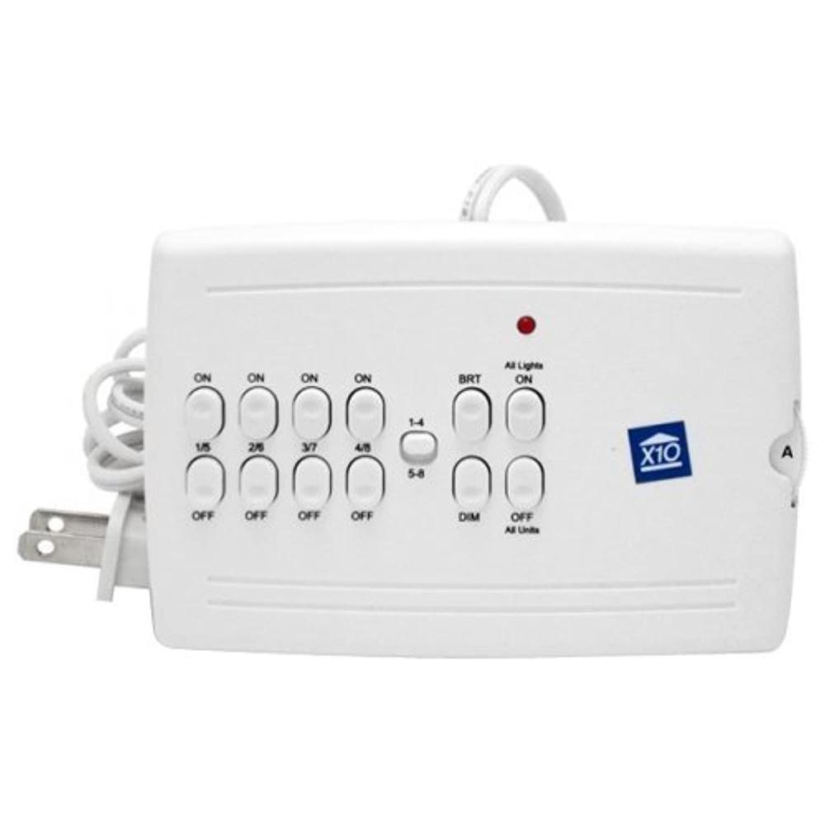
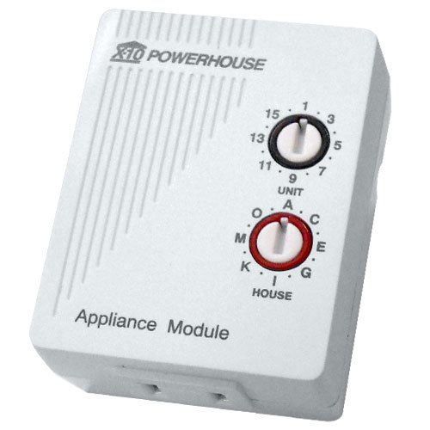

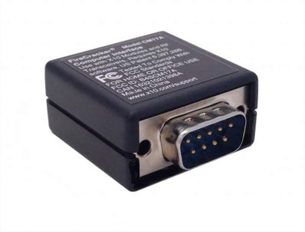
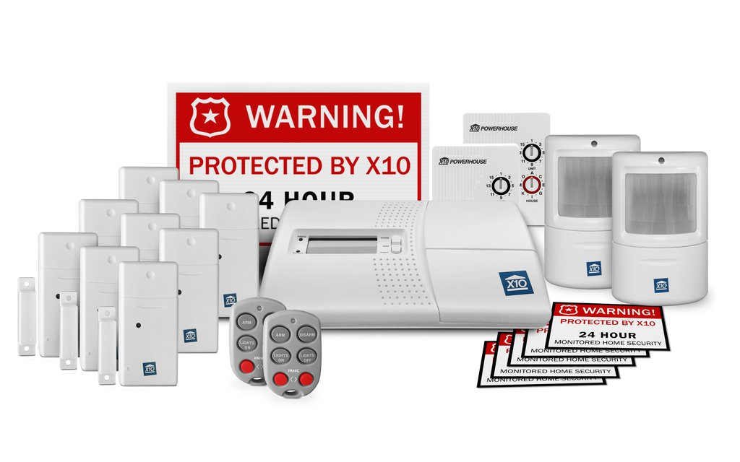
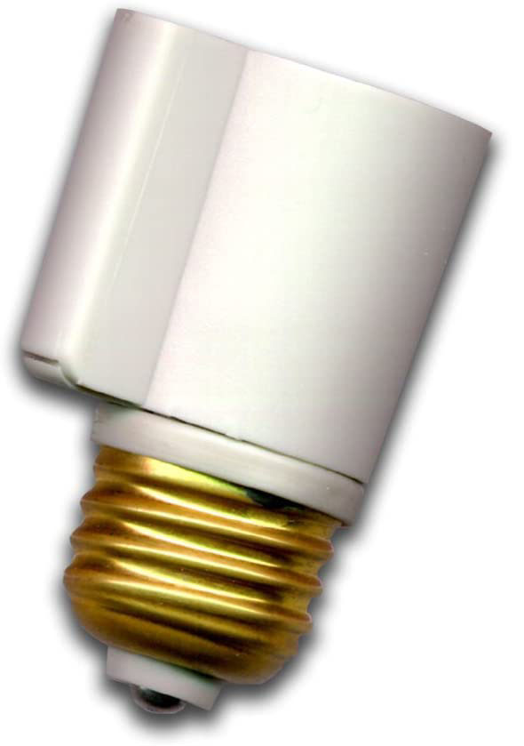
Old School
Notes:
Powerline control signals
20 bits / sec
Signal loss / leakage
Invented 1975 / Available 1978 at Radio Shack and Sears

Slide 4
What can you do with this home automation stuff?

Slide 5
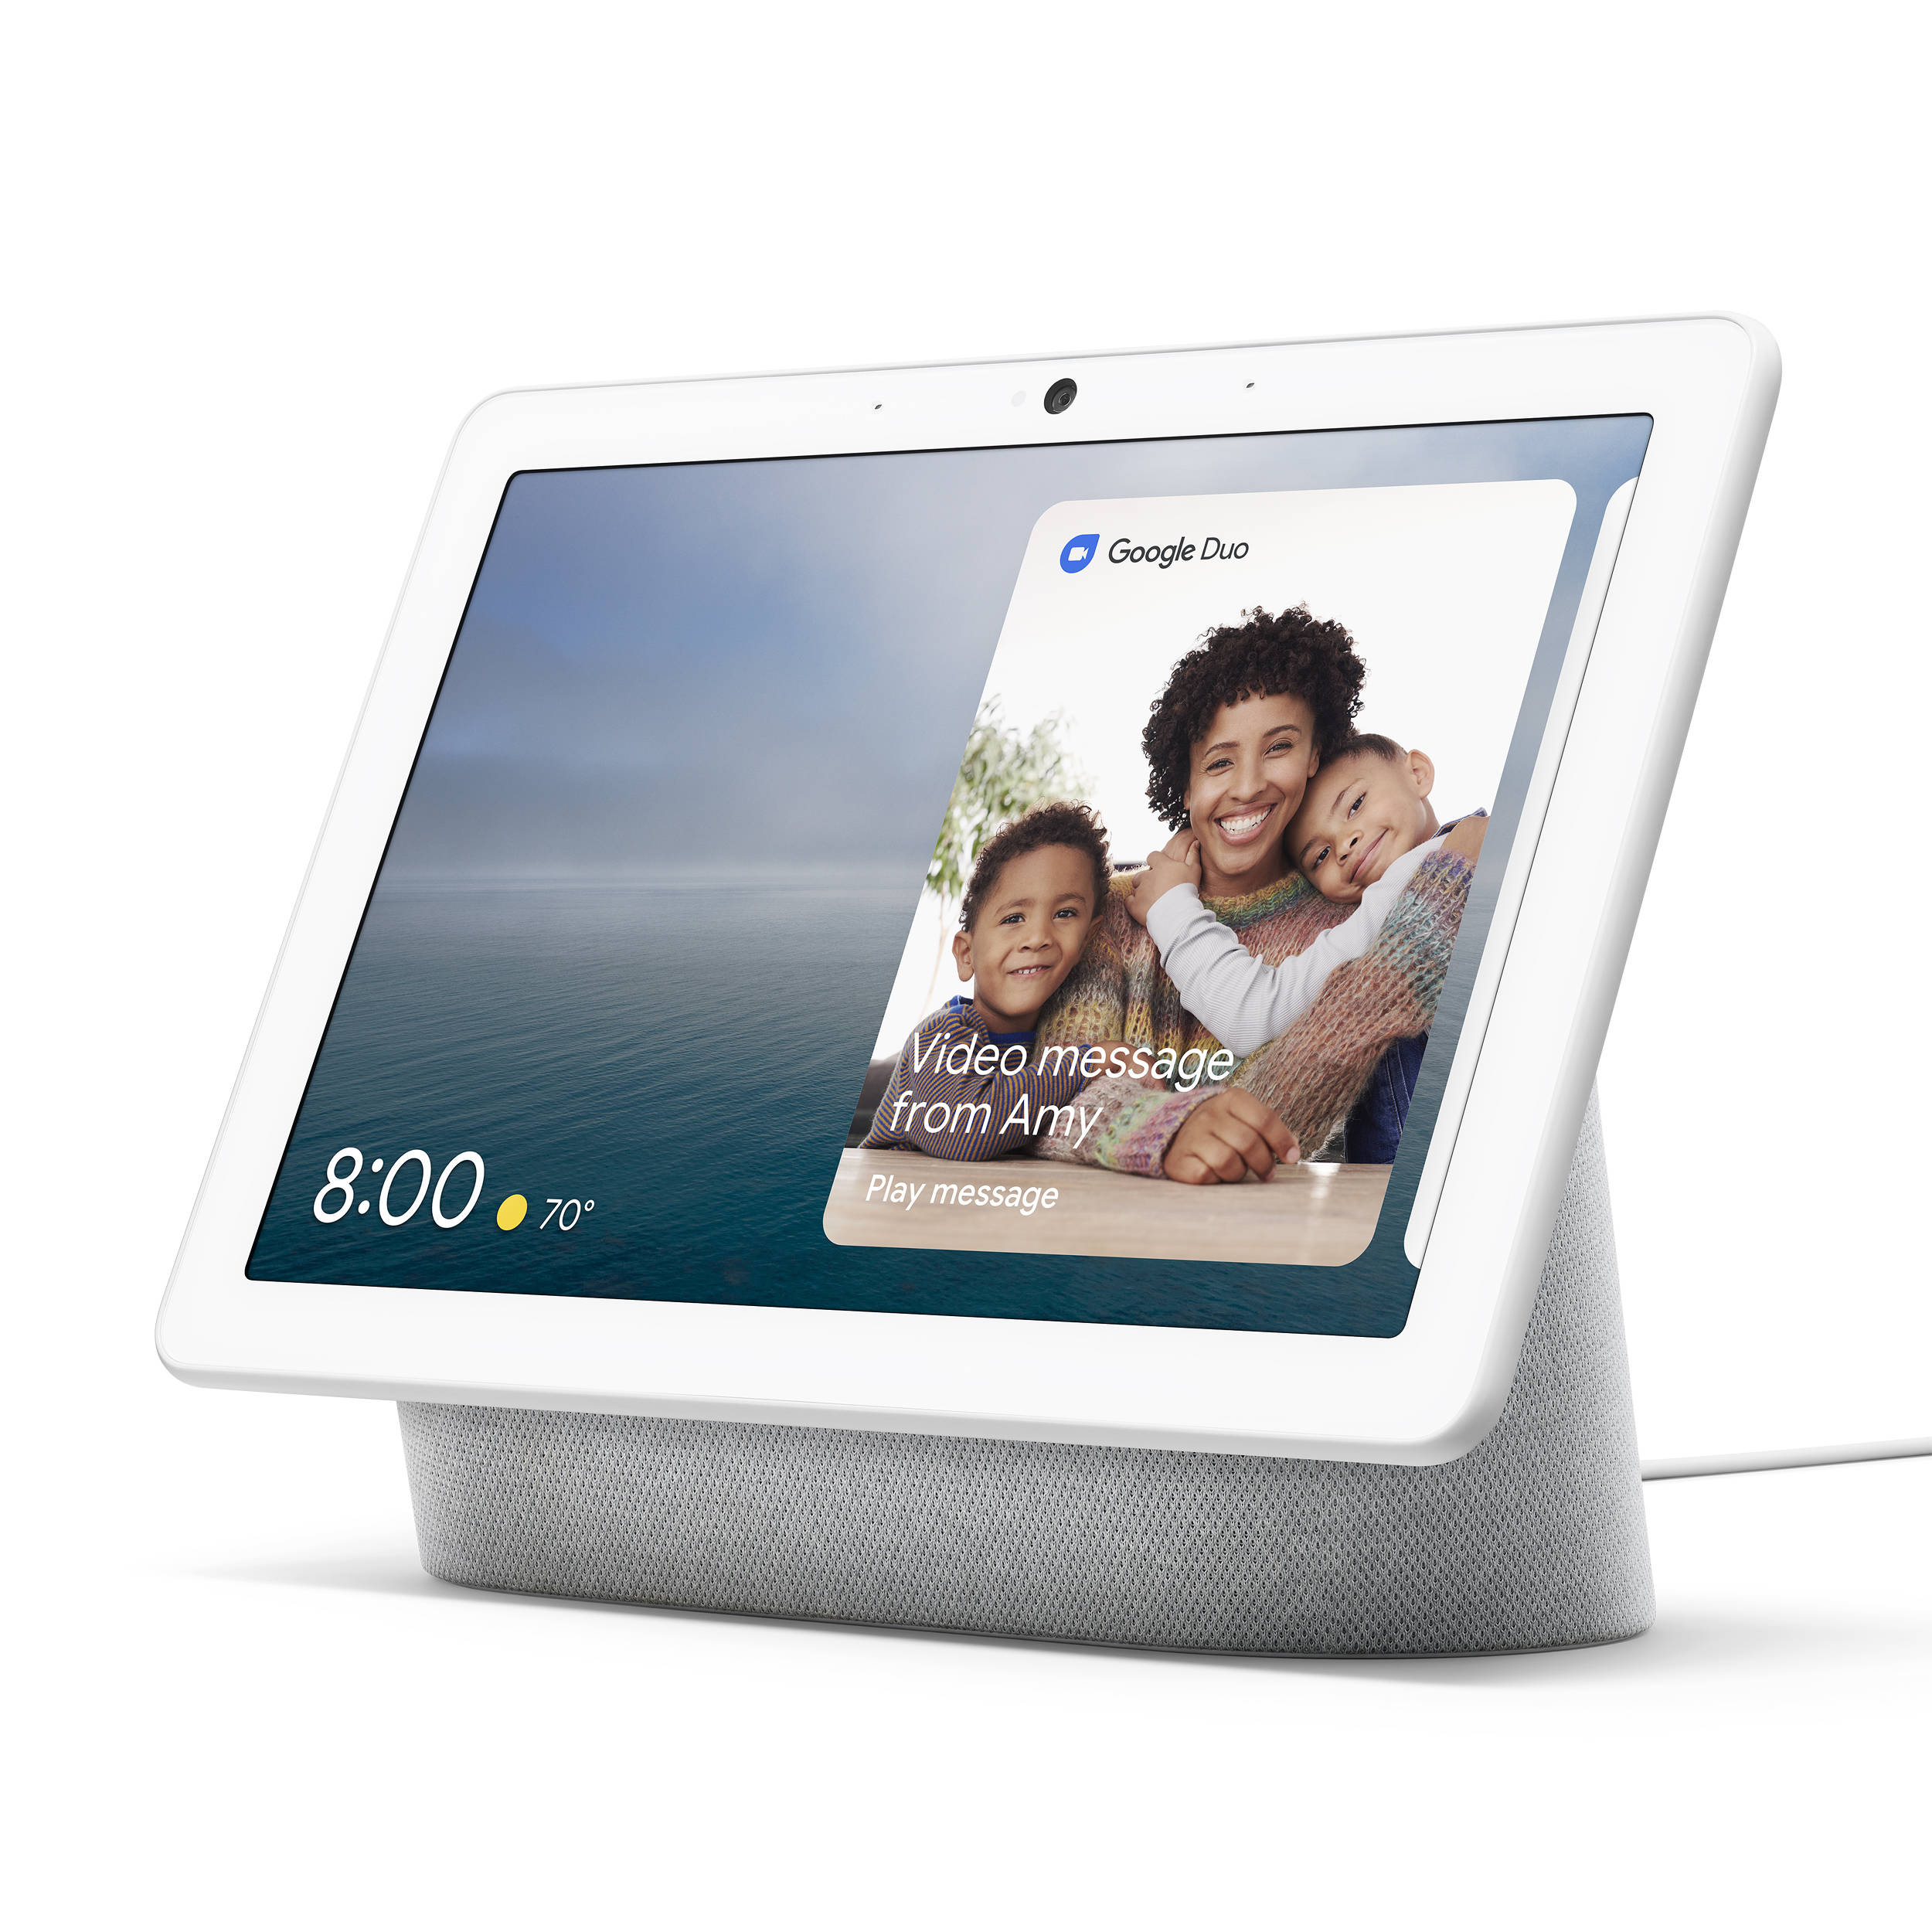
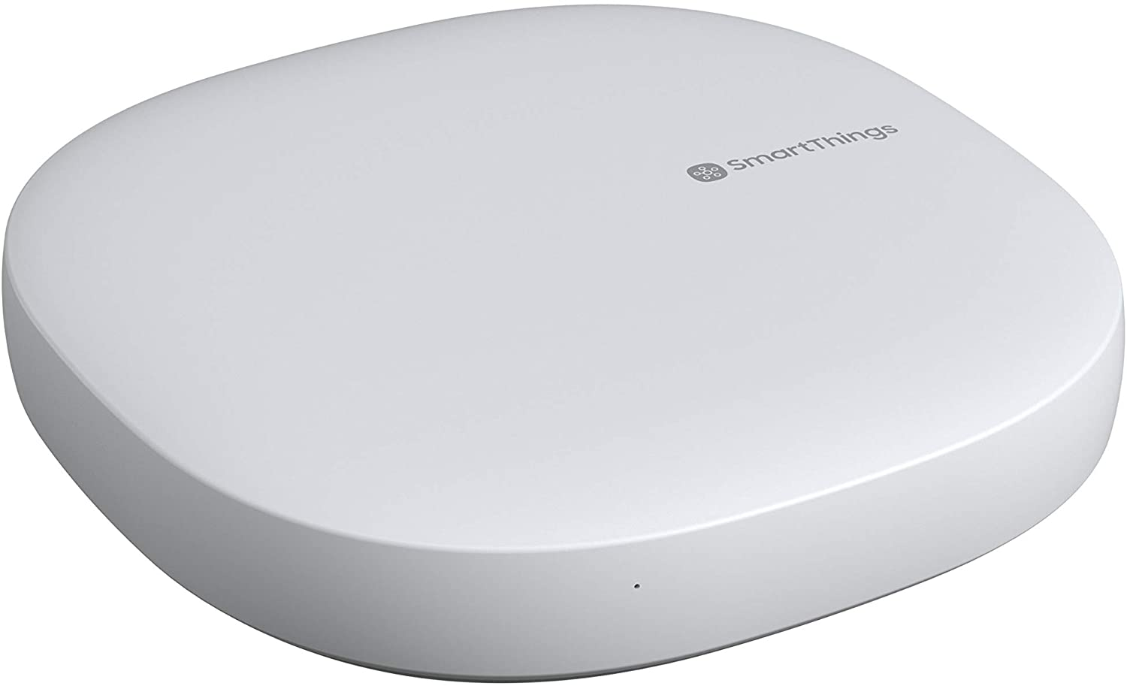






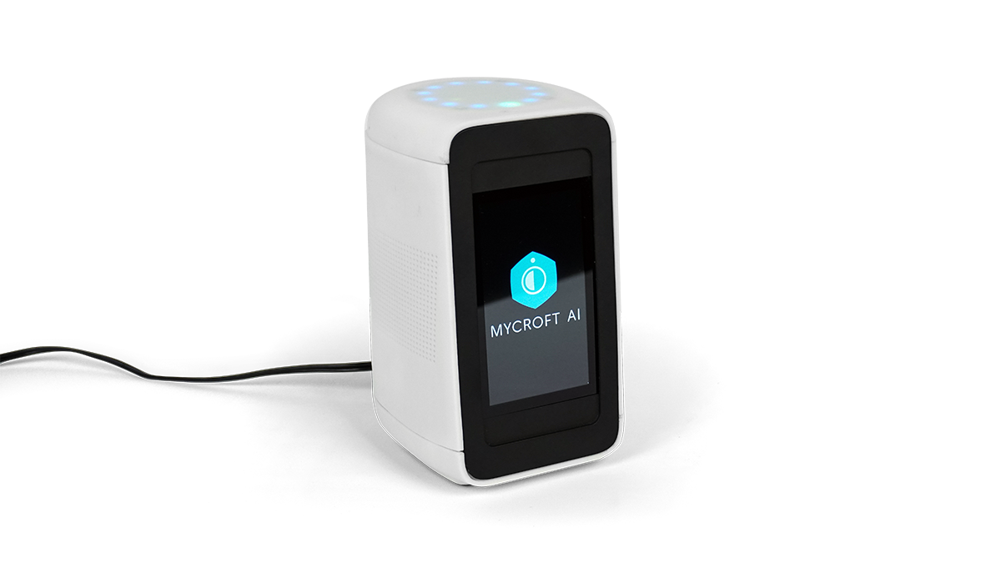

Ecosystems
SmartThings
Amazon
Google
Hubitat
Apple
Open Source

Slide 6




Open Source
Home Assistant

Slide 7

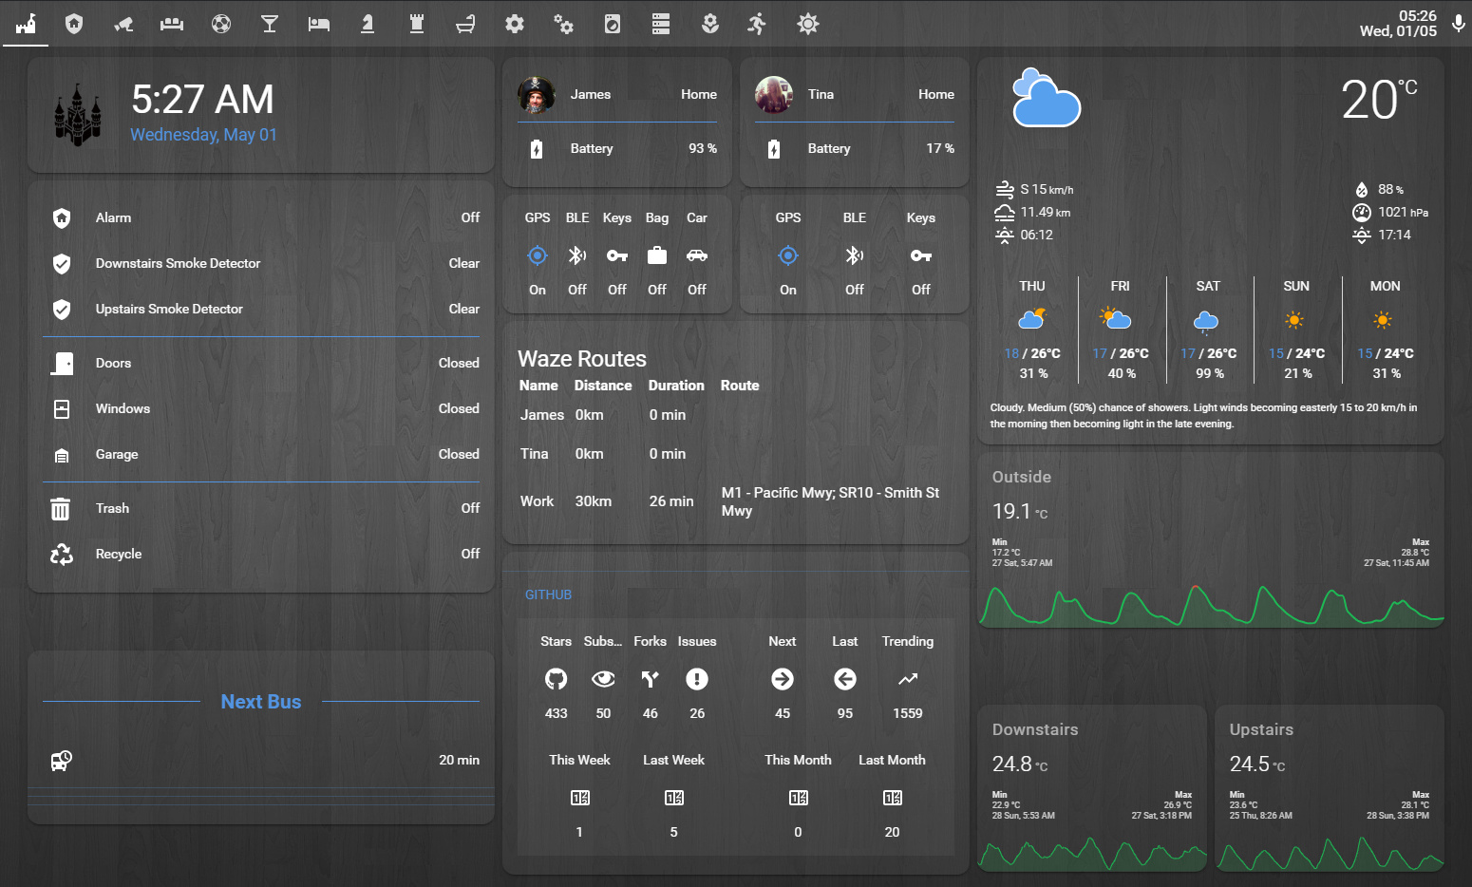
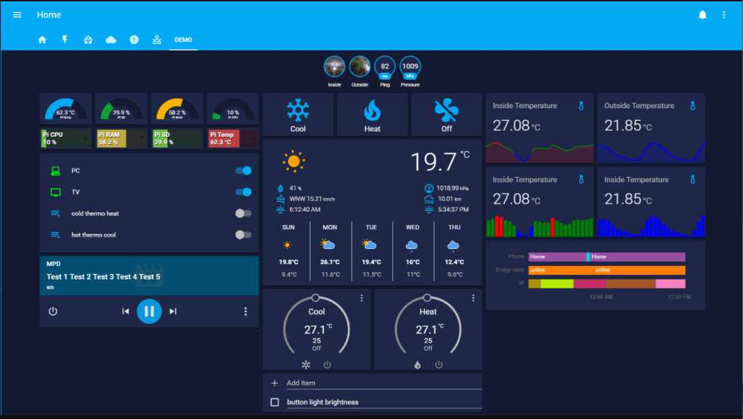
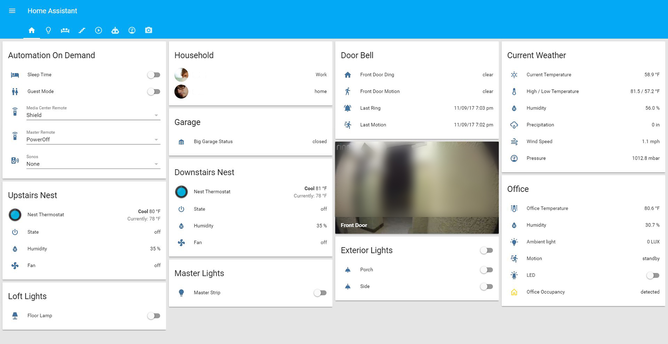
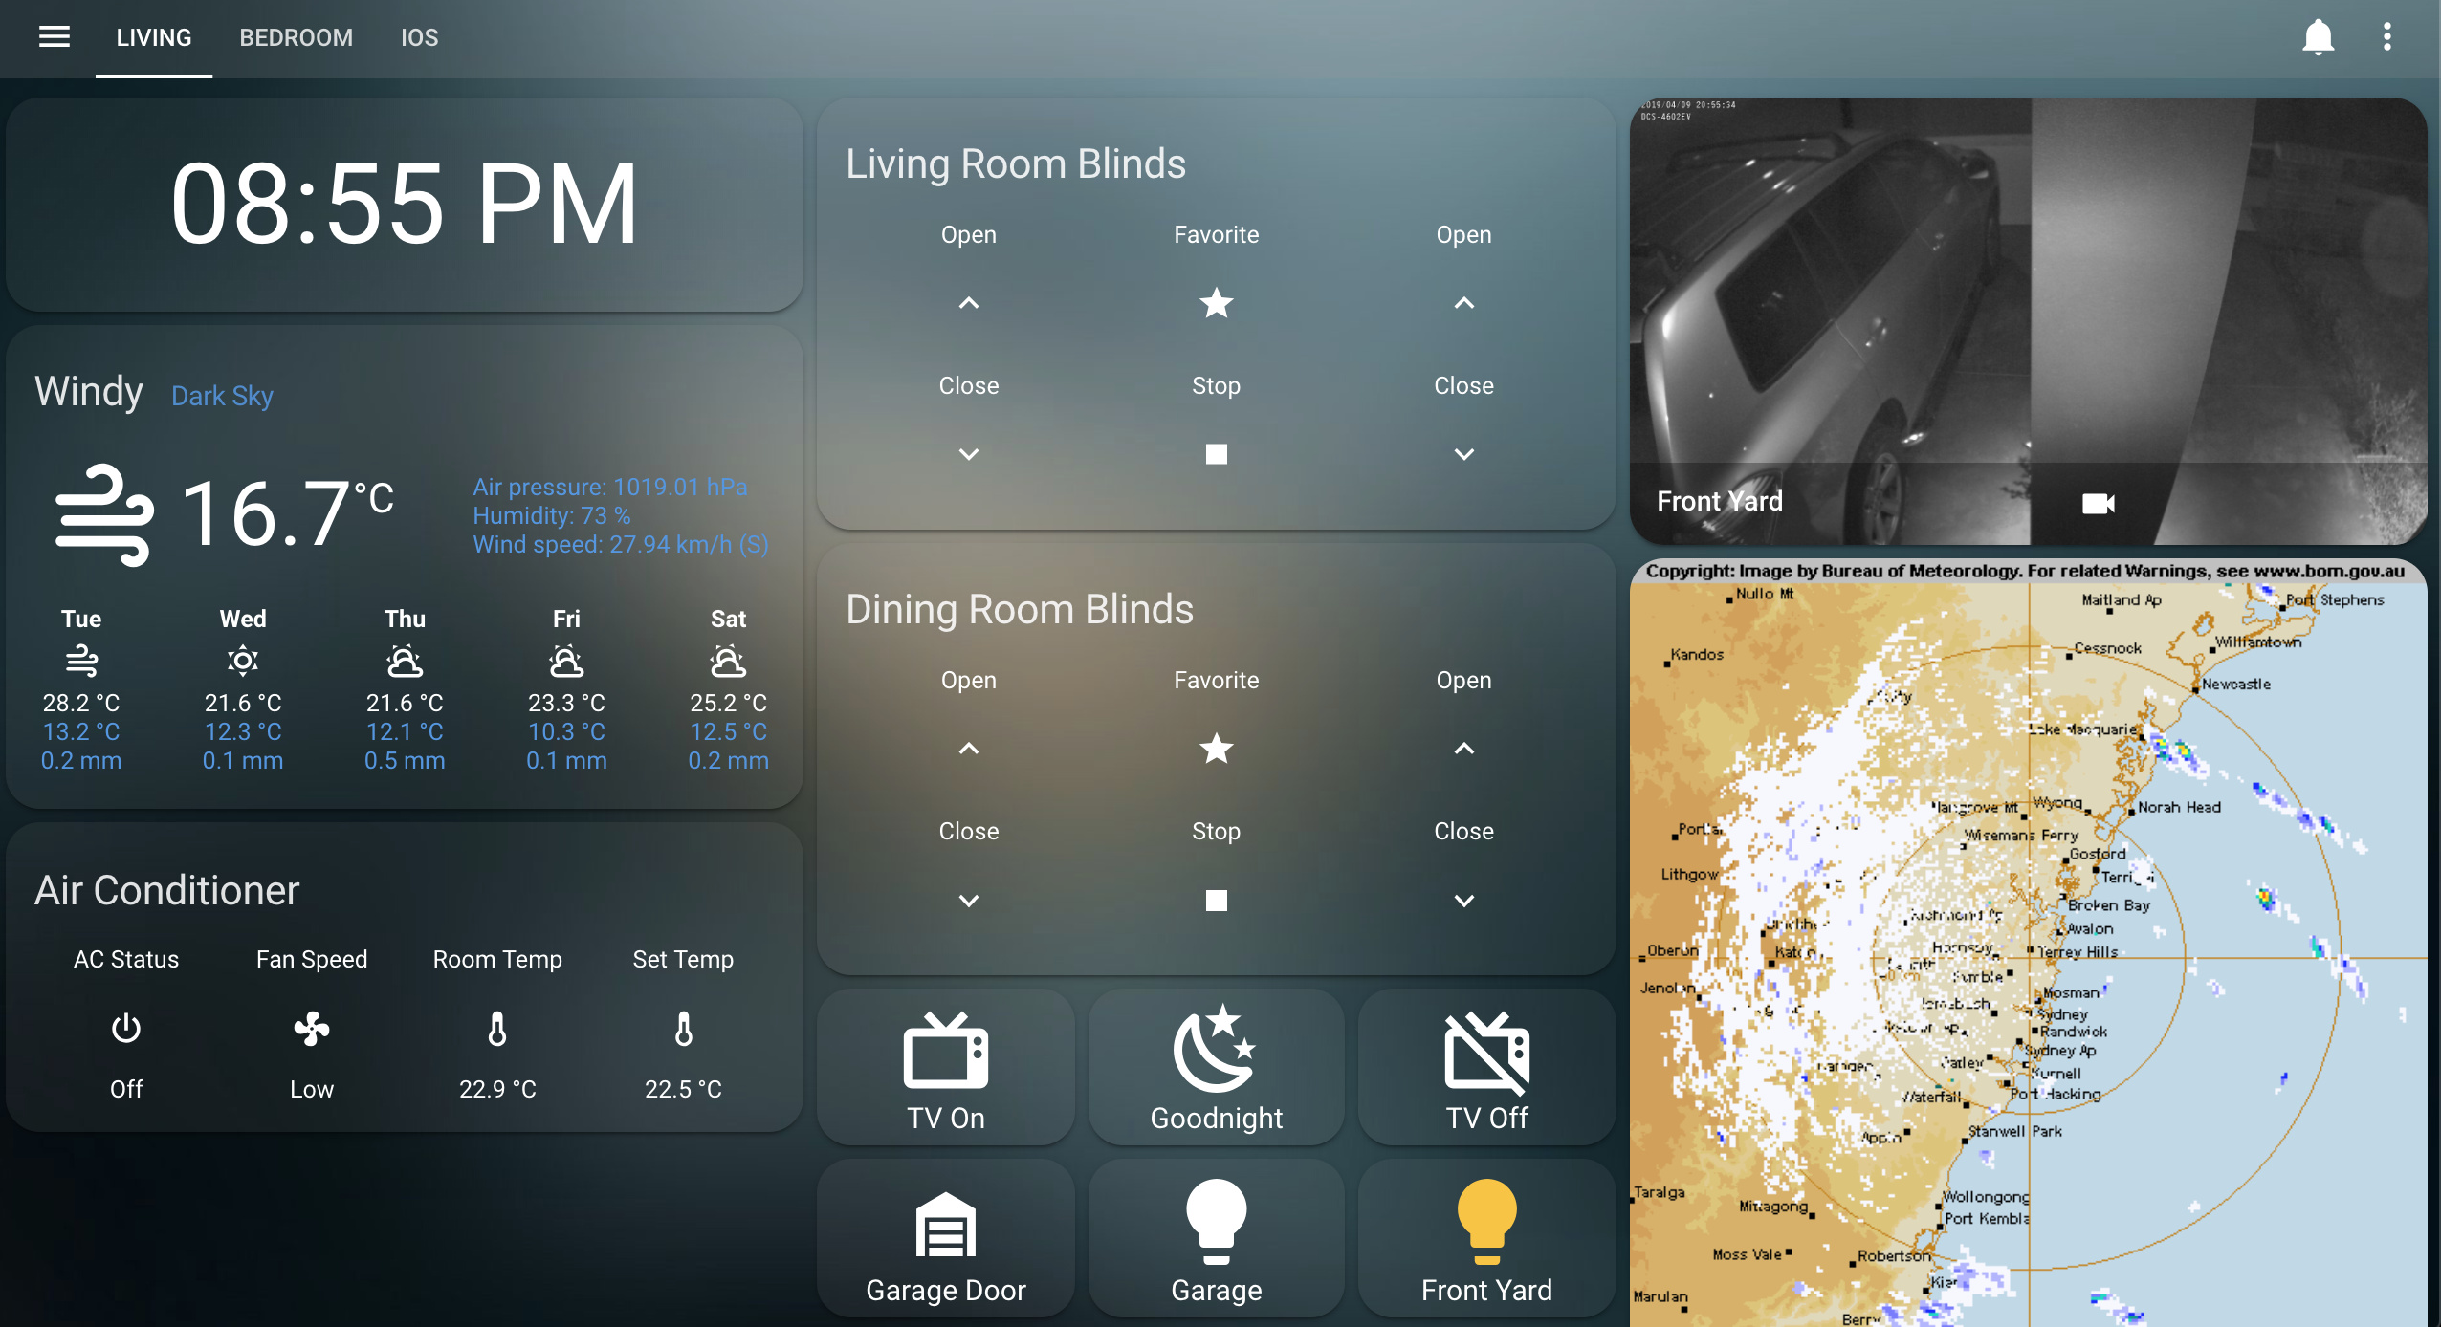
Home Assistant

Slide 8
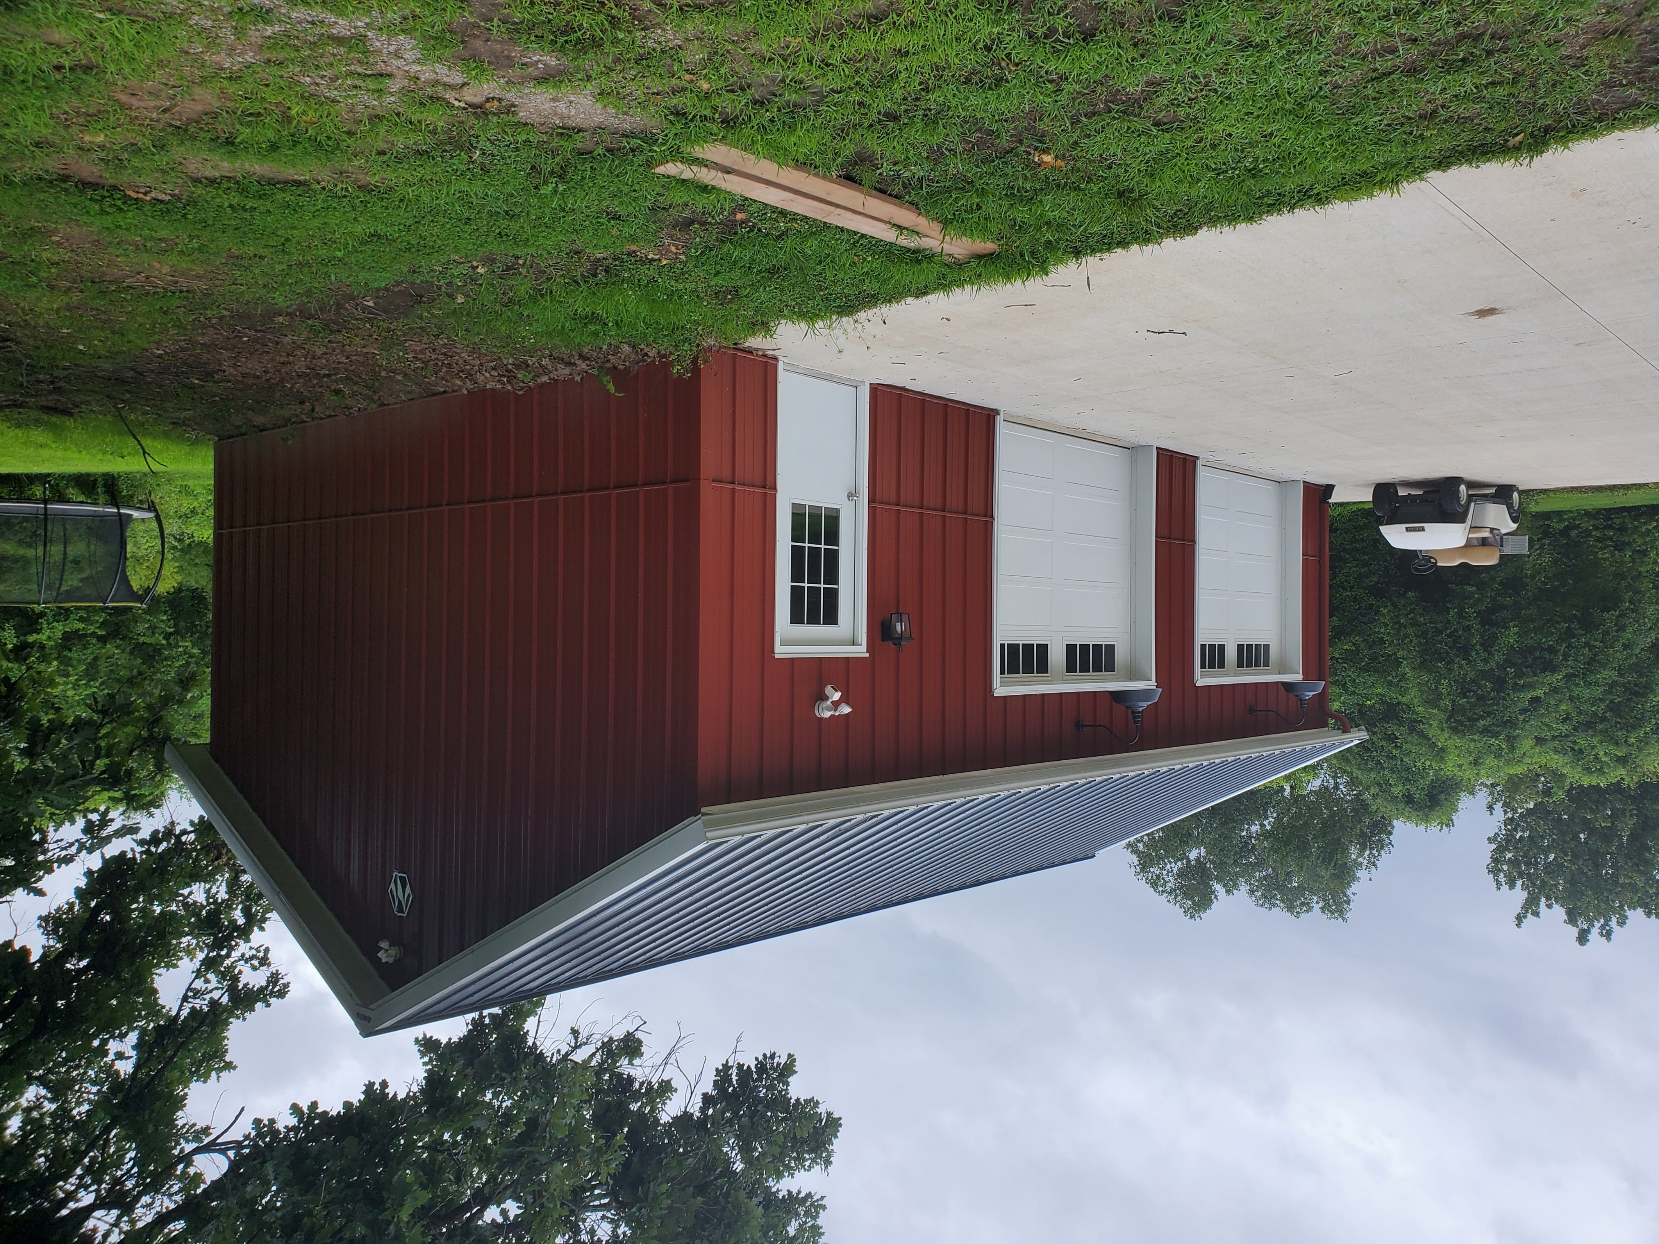
I built a workshop

Slide 9

The Problem
I needed light, a lot of light
But what if it’s to much light?
Or what if I need to turn the lights on and I’m stuck in a bear trap miles away?
Or what if all my friends say “You mean you have to use your hands? That’s like a baby’s toy!”
Photo of the inside of the shop at night

Slide 10
The Requirements
Enough light for highly detailed work
Dimmable lights in case the lighting is uncomfortably bright
Integrate with the existing home automation system

Slide 11
The Research
#1 - Enough light for the expected tasks
Read about other people’s shop lighting
Lumens, Foot Candles, and Lux oh my
Decided that 100-150 lumens per sq ft target
Results
23 Lights @ 5,720 lumens each
Total of 131,560 lumens over 800 sq ft
Results in ~ 165 lumens per sq ft

Slide 12
The Research
#2 - Dimmable lights in case the lighting is uncomfortably bright
LED dimming can cause flickering
Use commercial lighting
Decided on 0-10v dimmable lighting

Slide 13
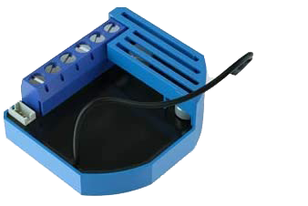
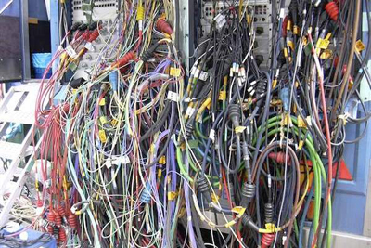
The Research
#3 - Integrate with the existing home automation system
Control options
Qubino 0-10v Z-Wave Dimmer
Roll my own

Slide 14
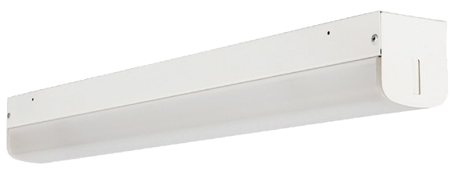
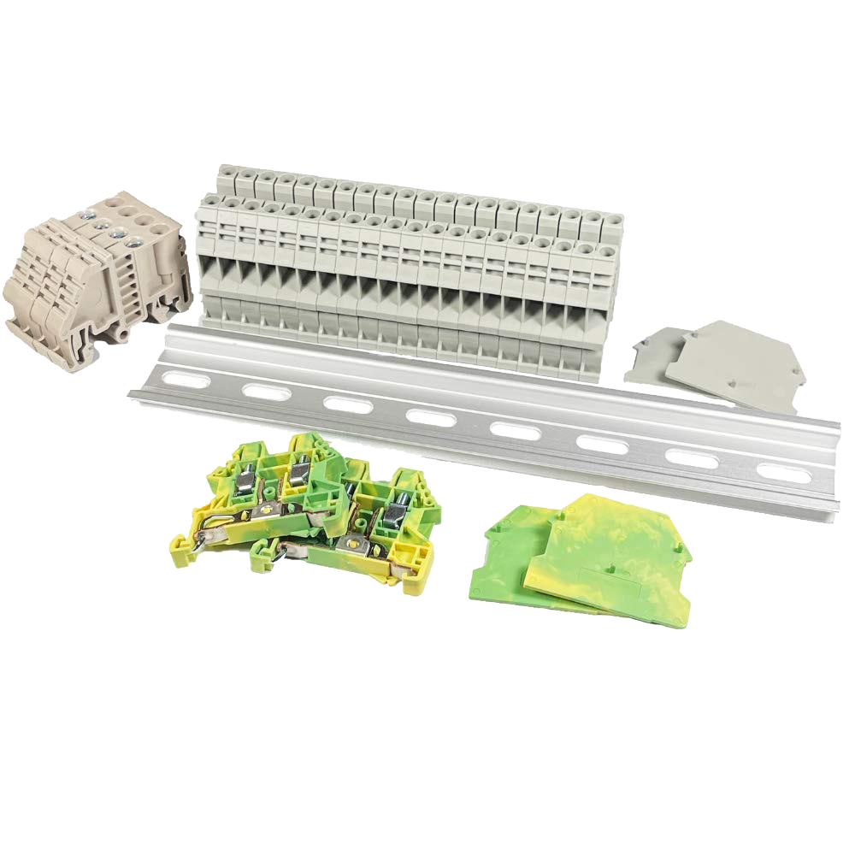
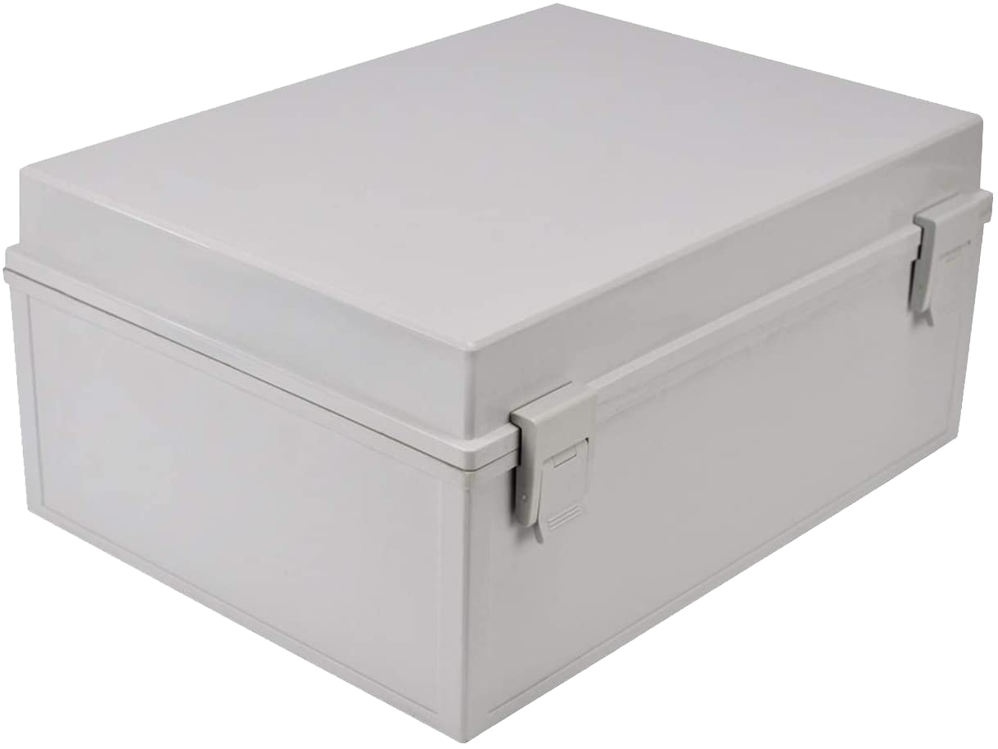
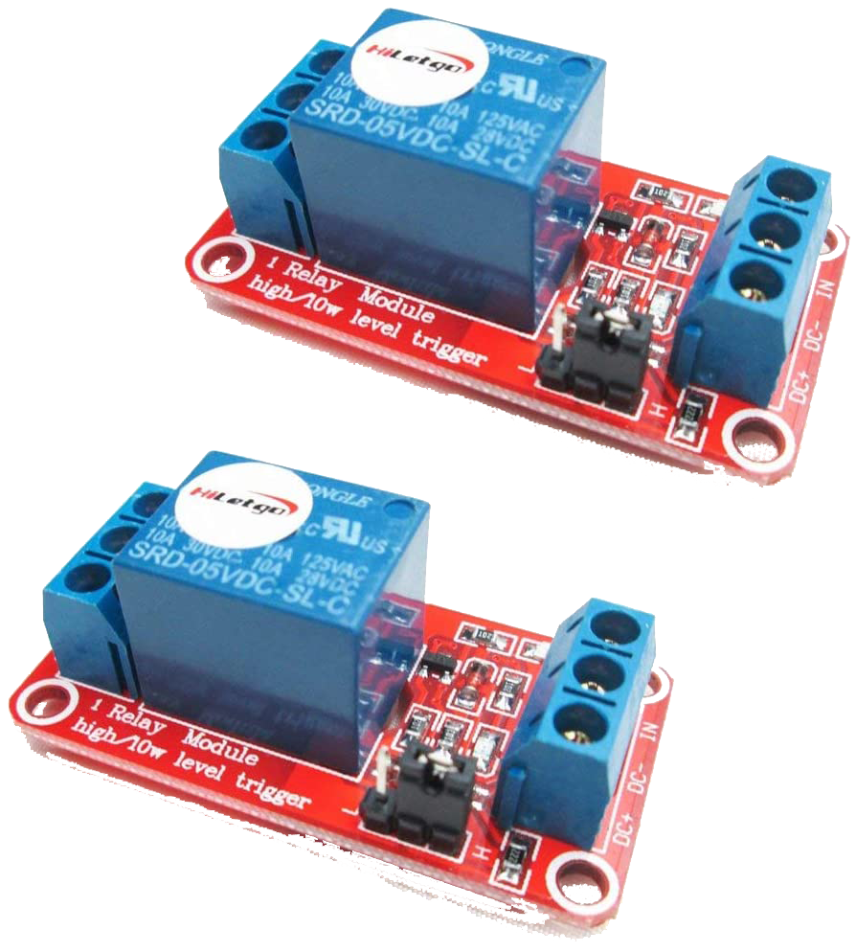
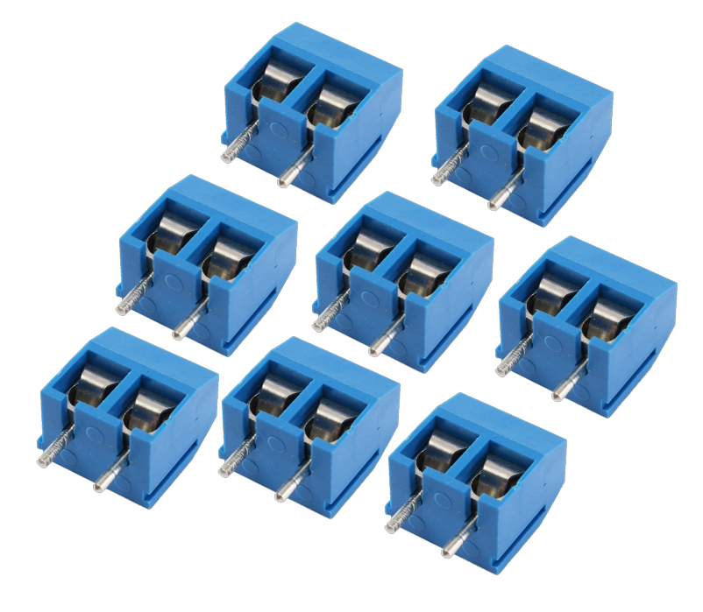
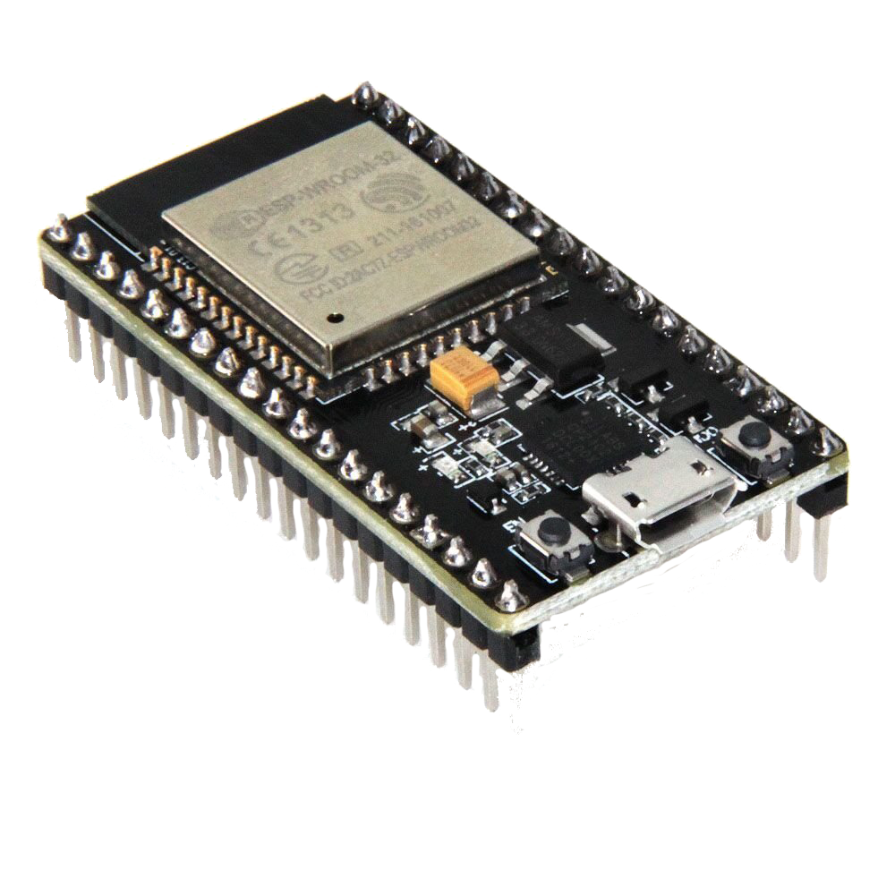
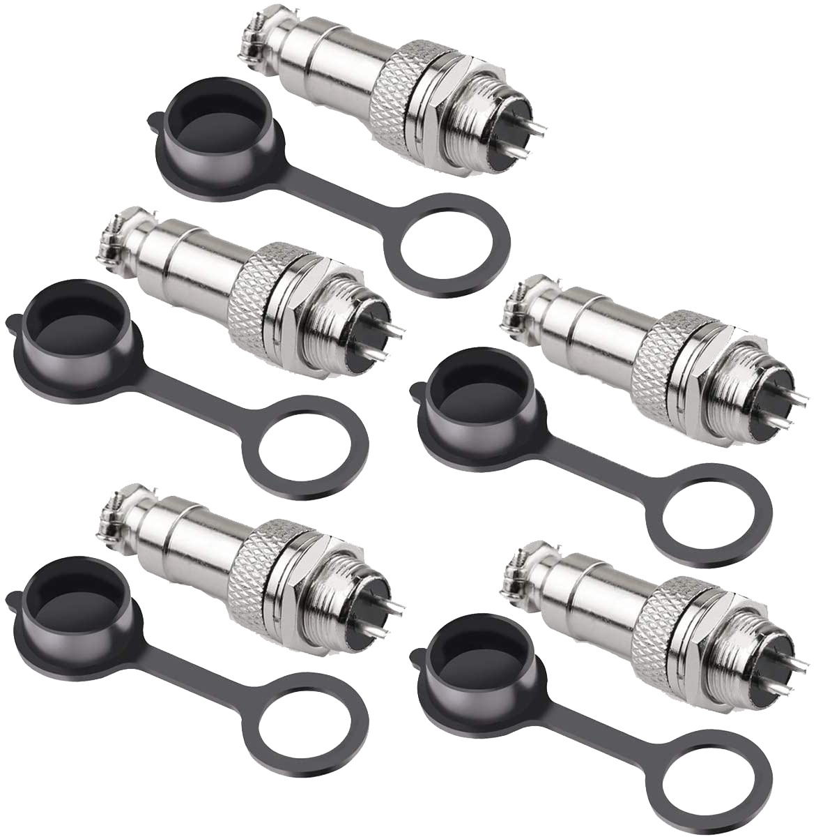
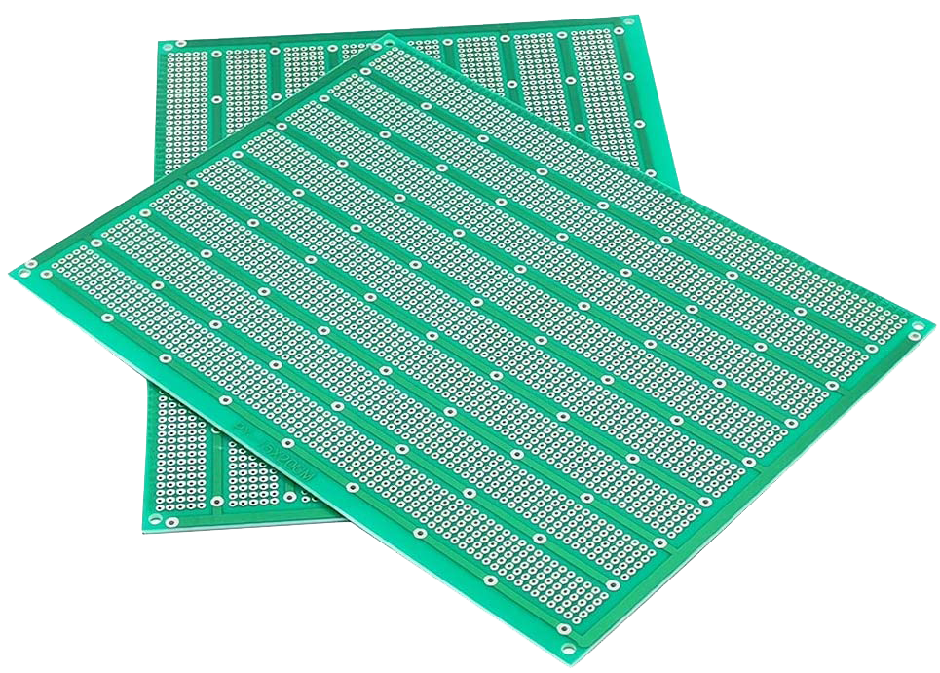
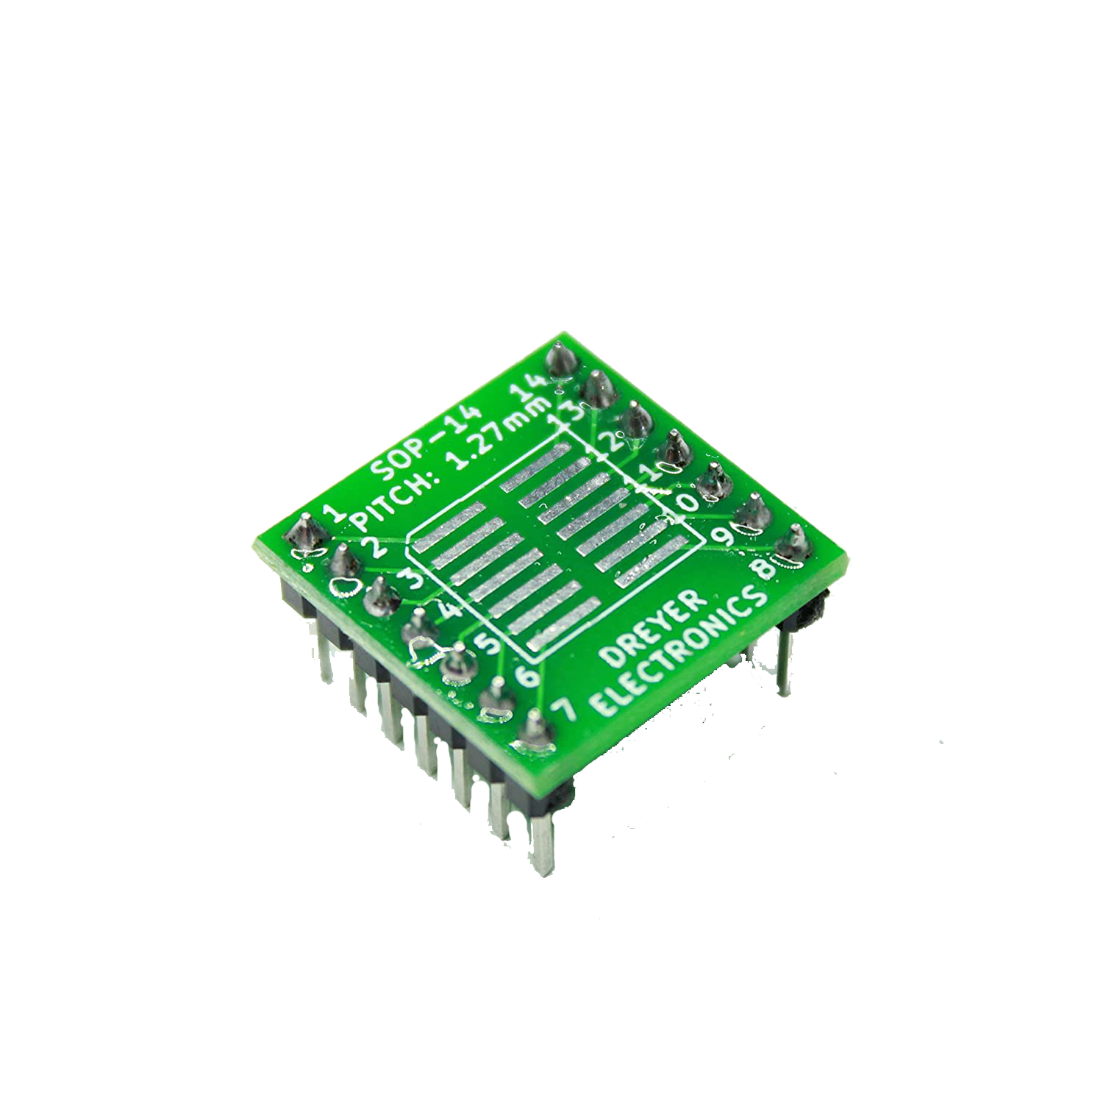
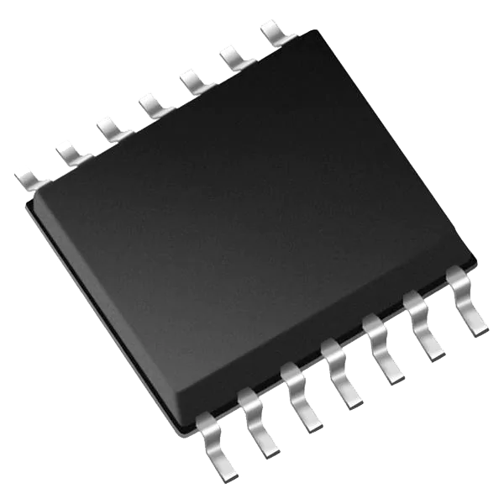
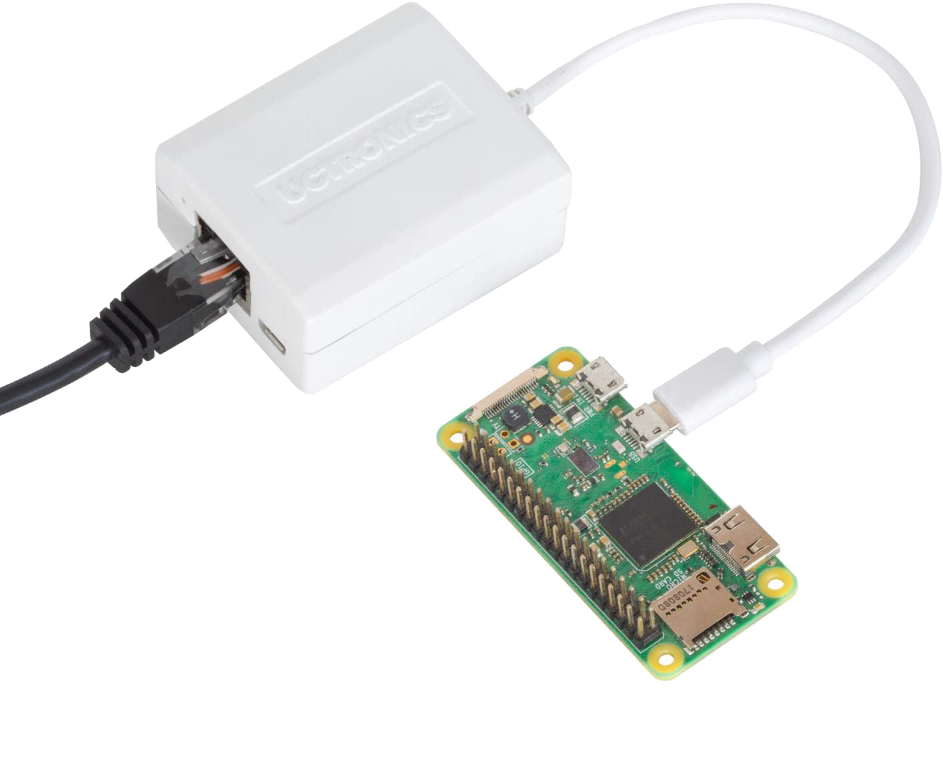
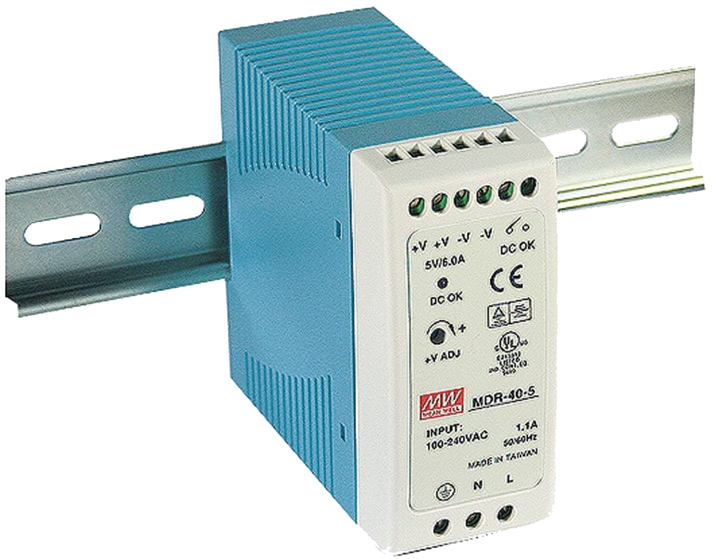
The Parts

Slide 15
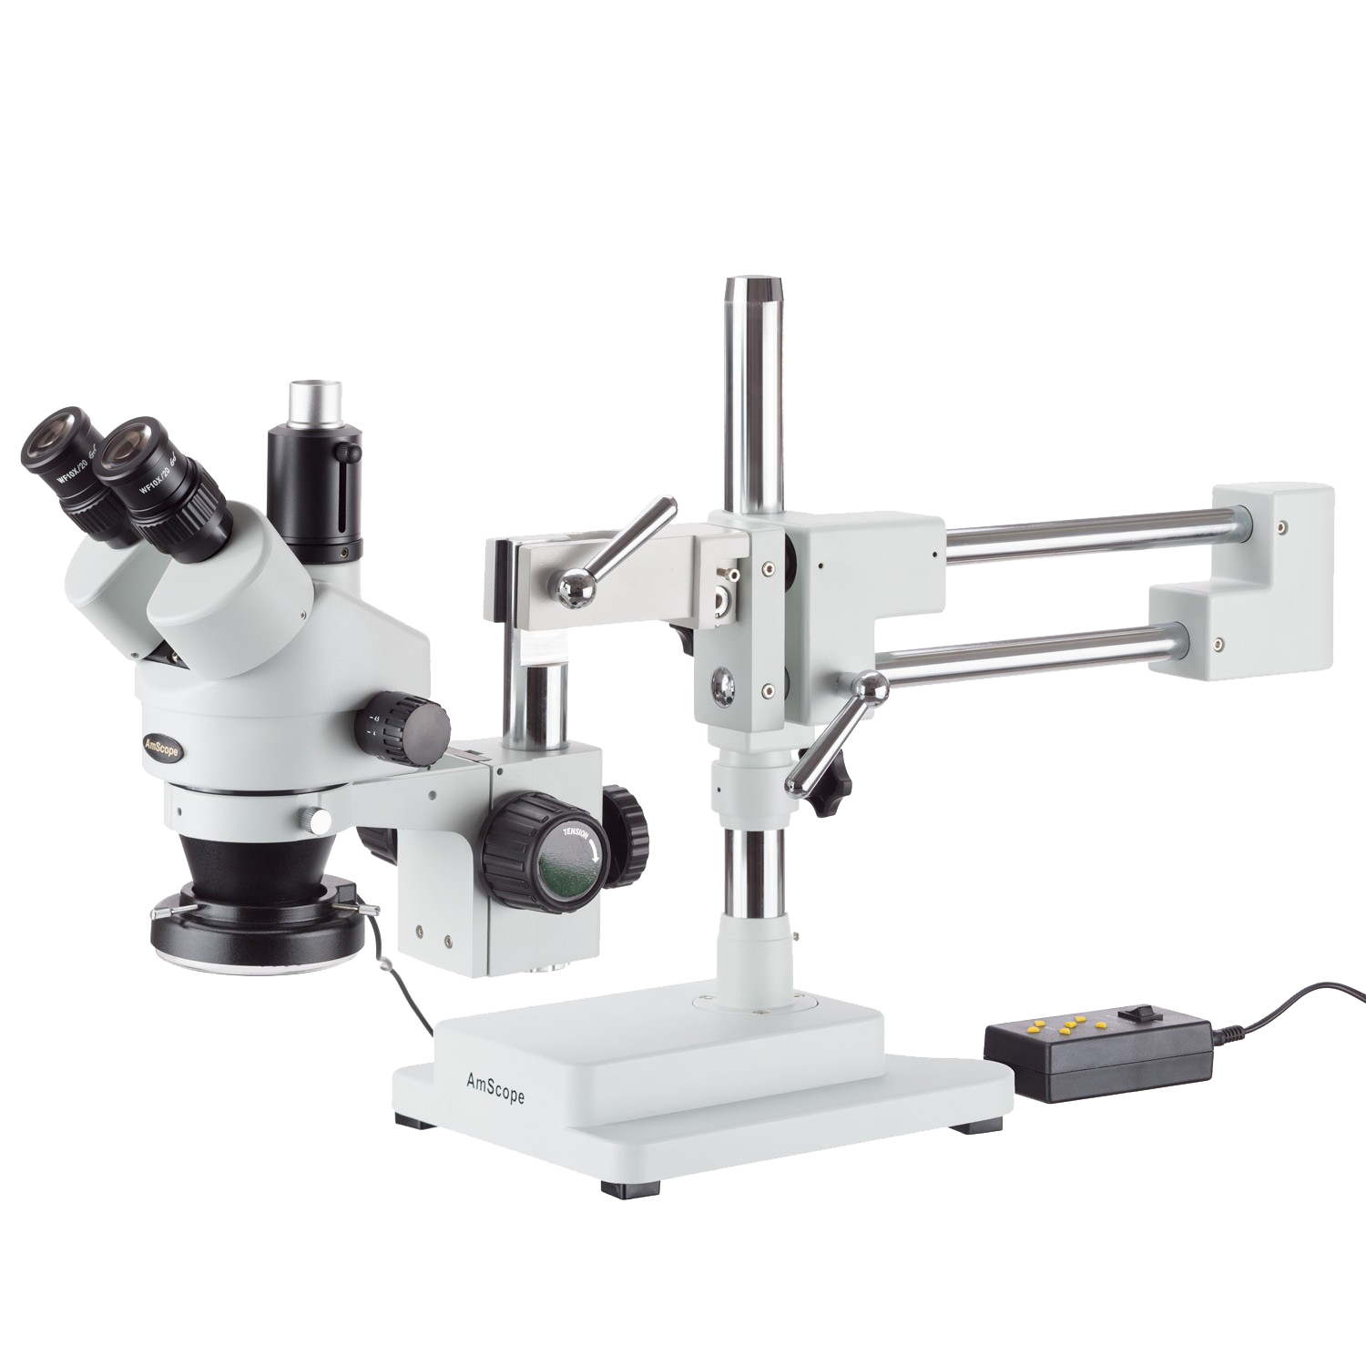
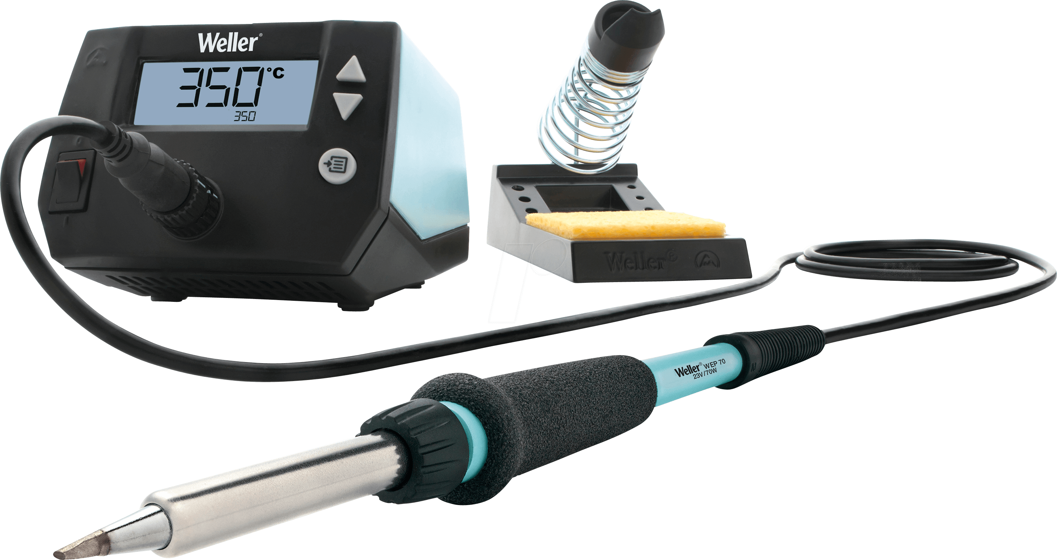

The Process

Slide 16
The Code
Used Arduino running on an ESP32 micro
Additional libraries
ArduinoOTA – Provides OTA update support
PubSubClient – Provides MQTT support
ArduinoJson – Provides JSON parsing
MCP41HVX1 – Provides control over digital pots
Less than 250 lines of code
Less than 250 bugs (so far)

Slide 17
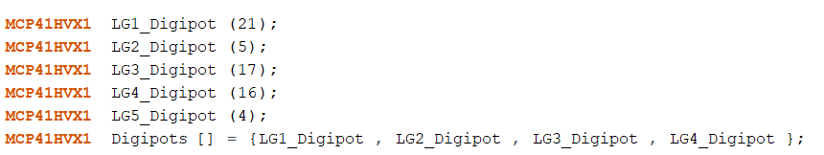
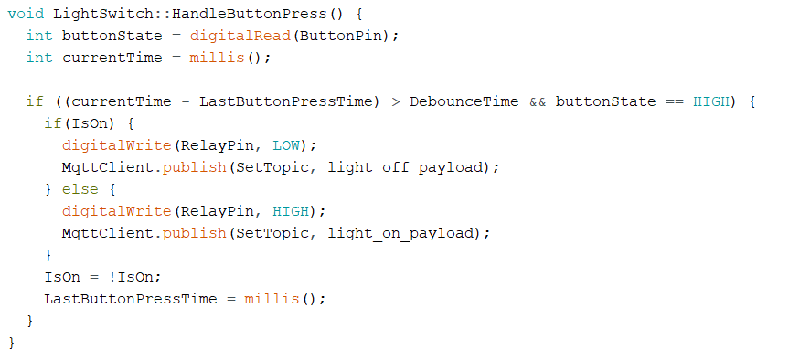
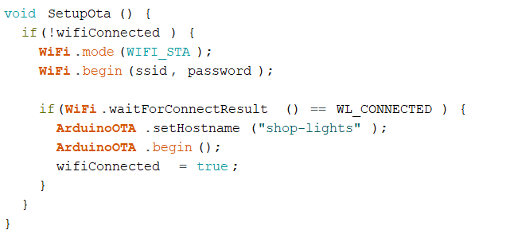
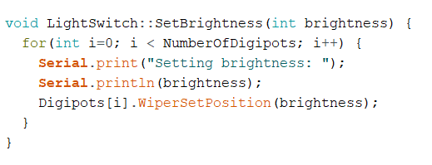
The Code

Slide 18
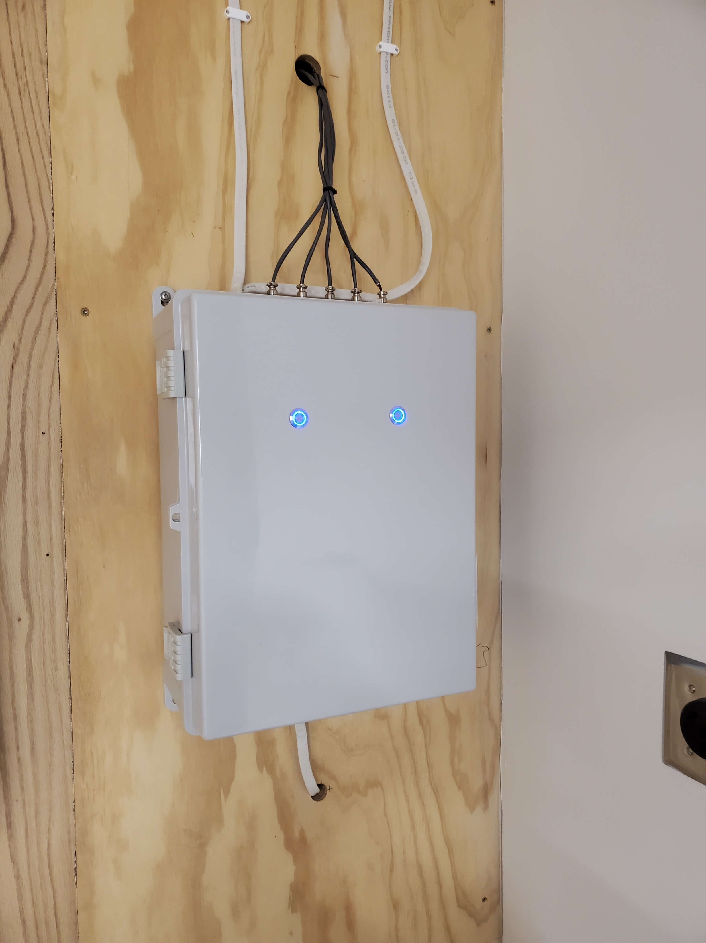
The Results

Slide 19
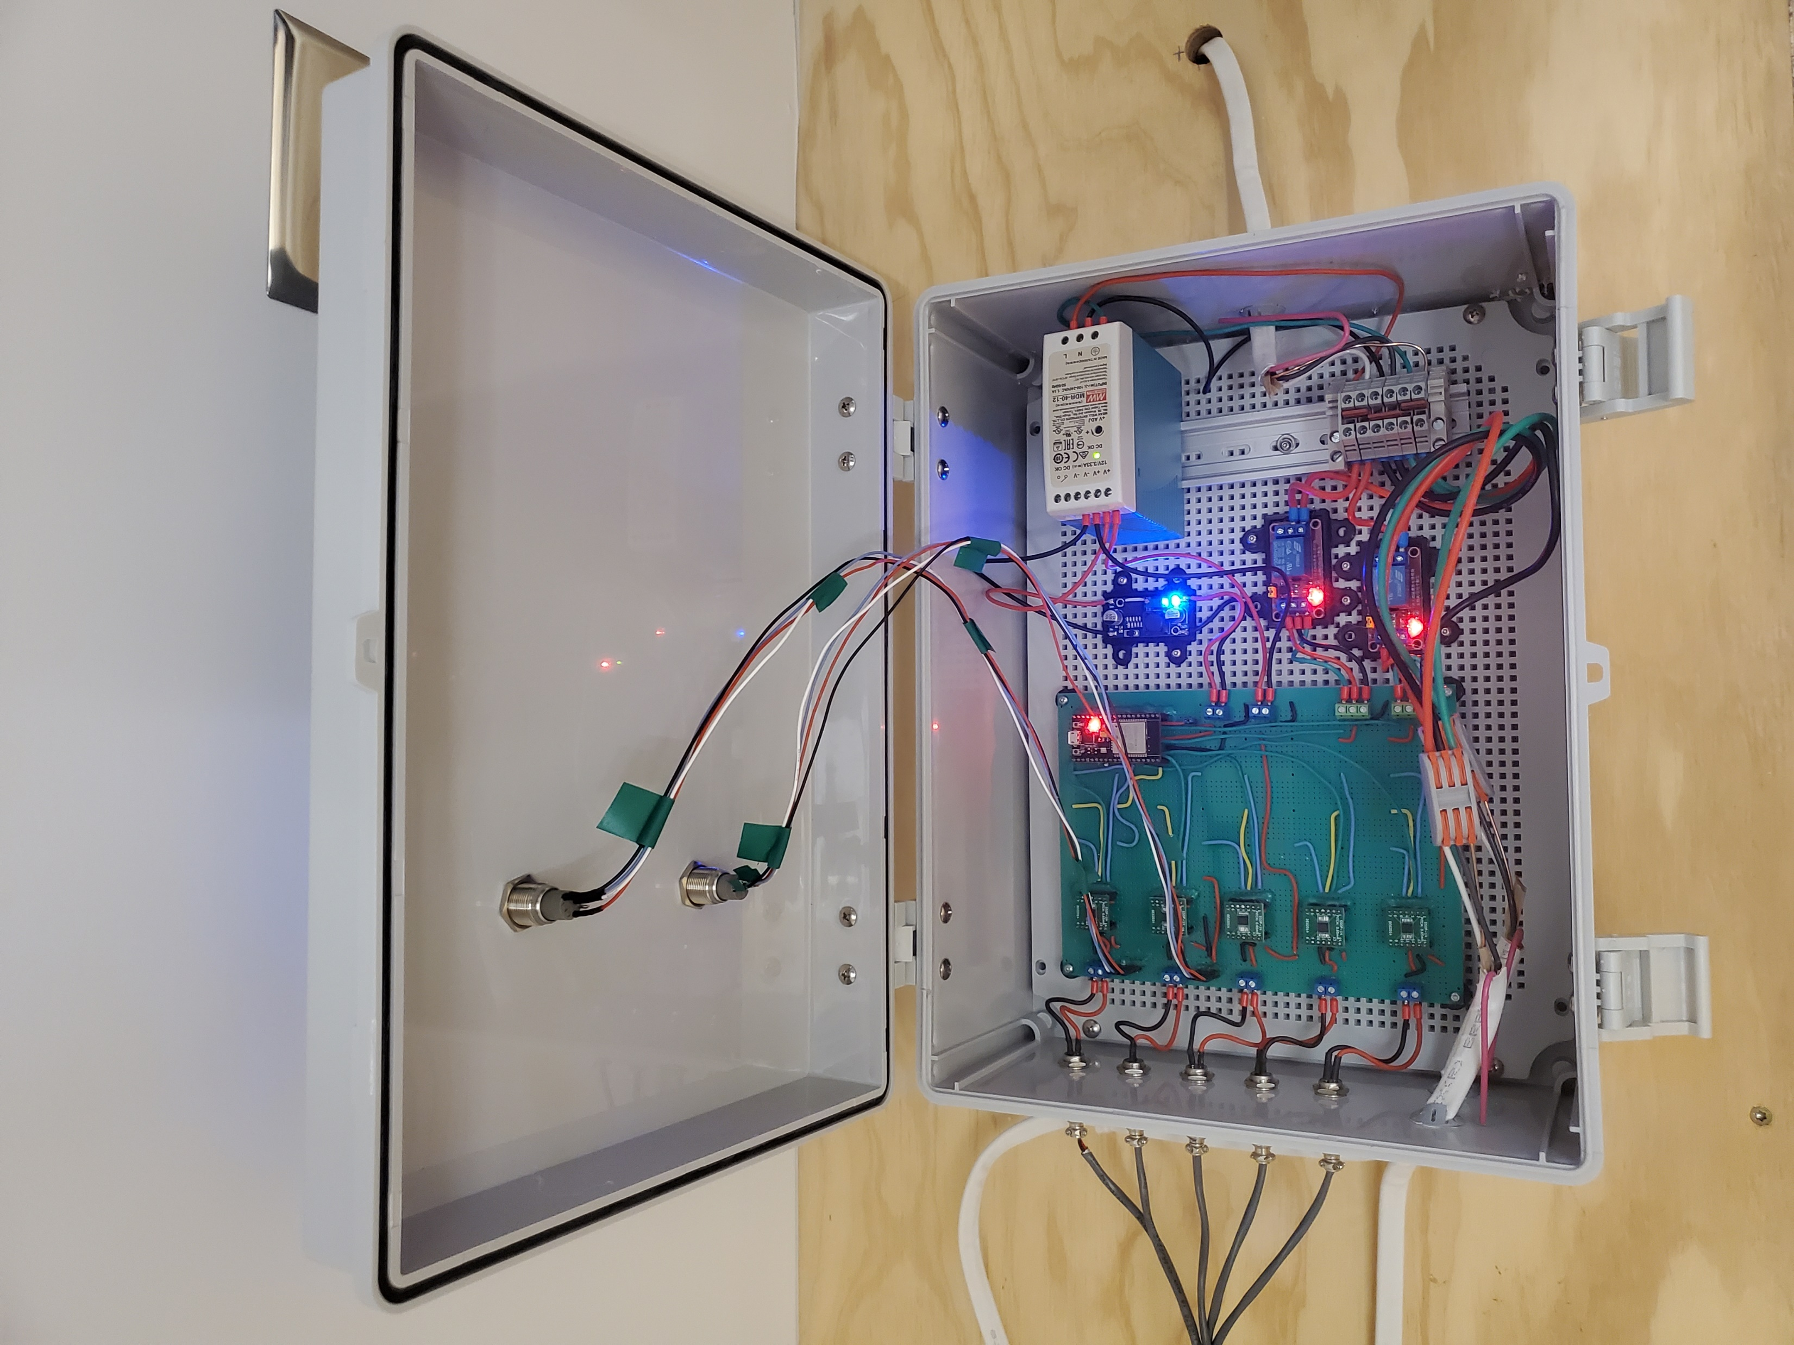

Slide 20
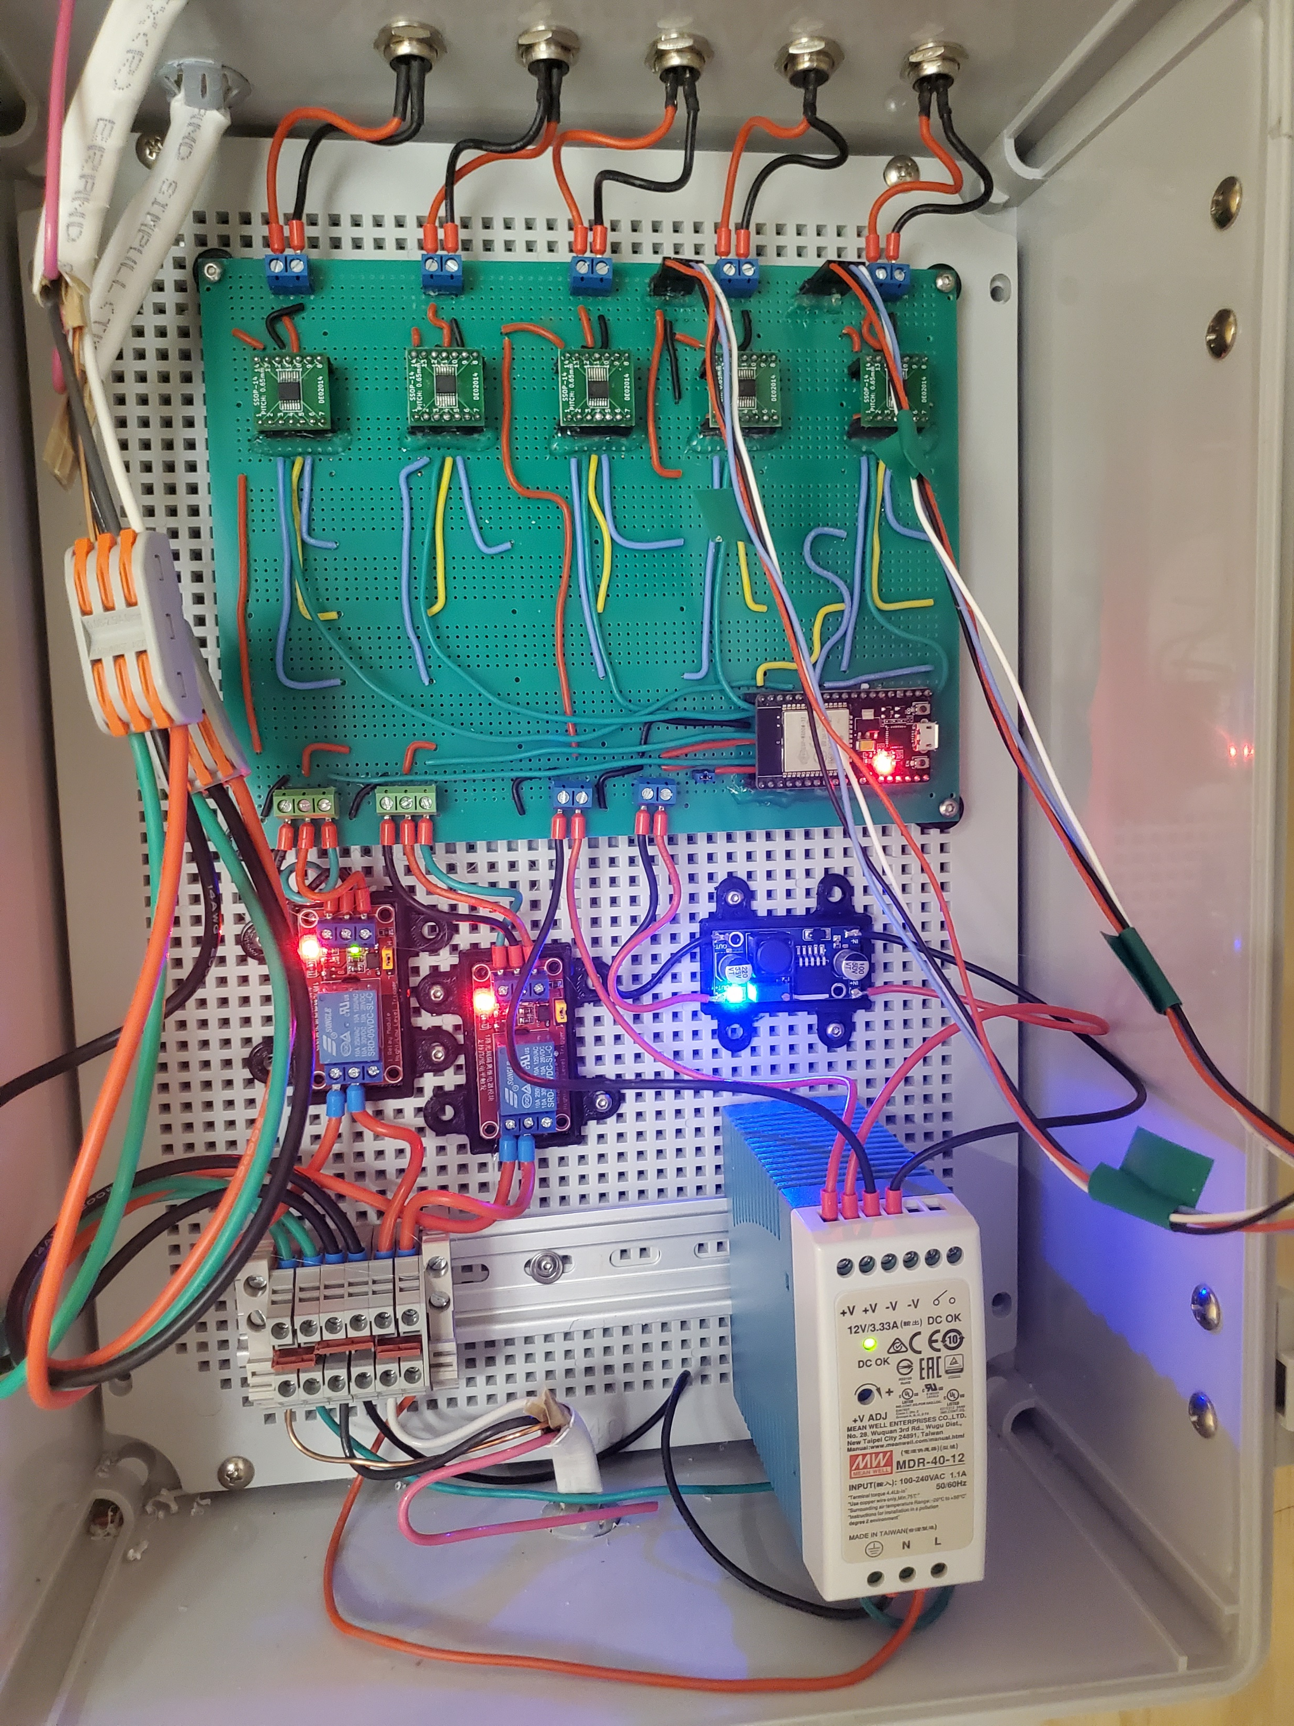

Slide 21
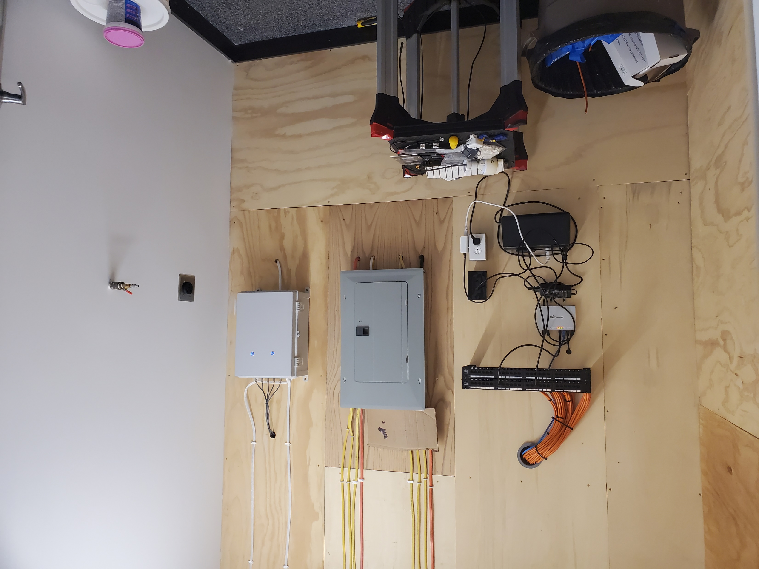

Slide 22
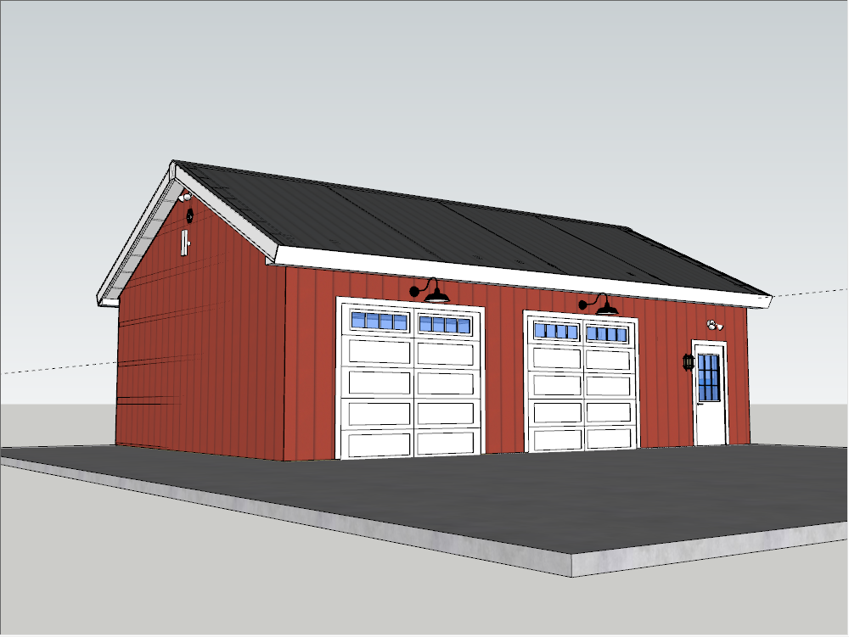
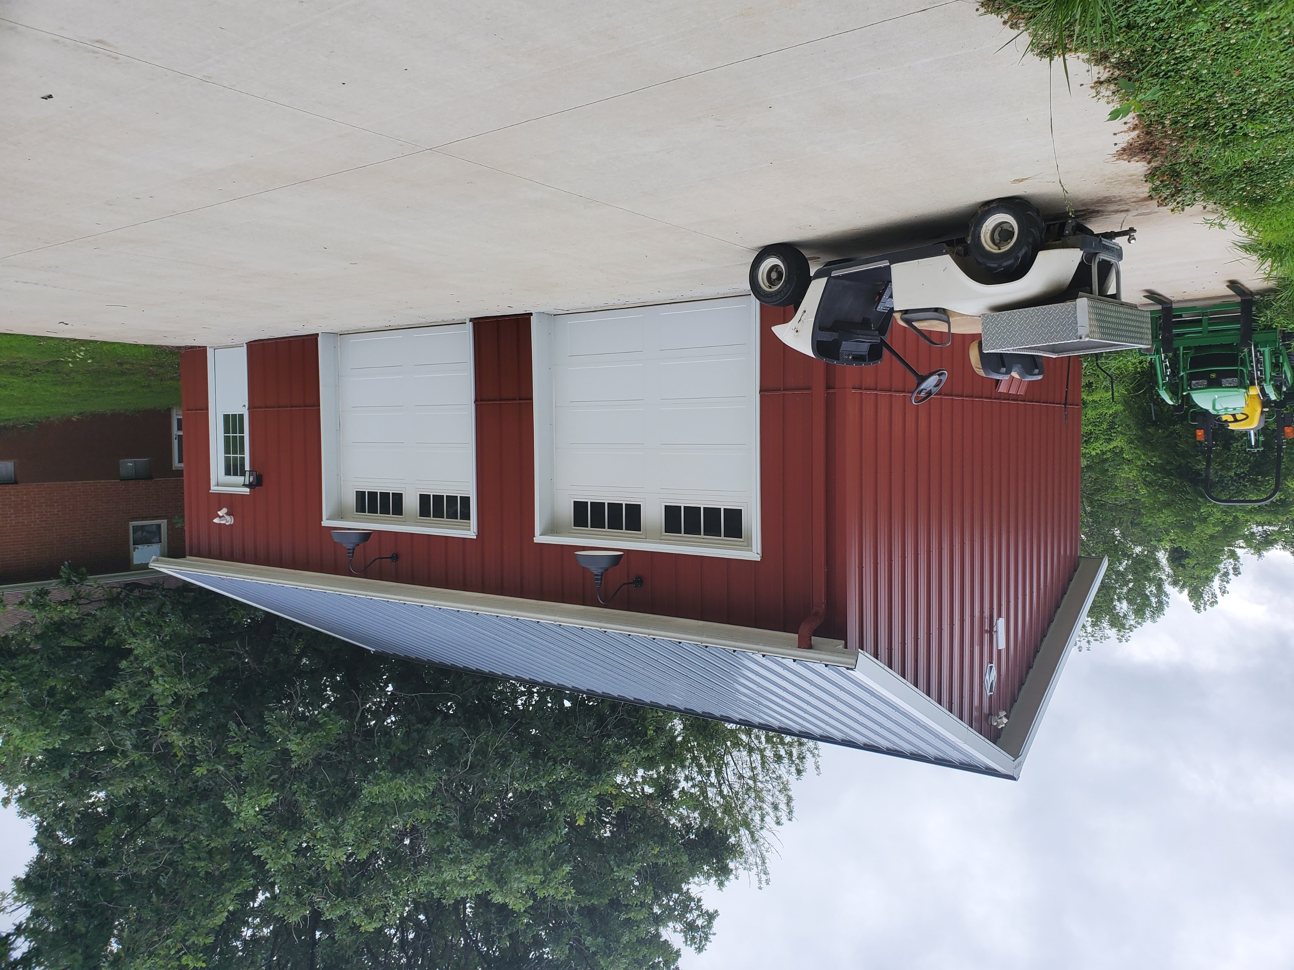
The Shop

Slide 23
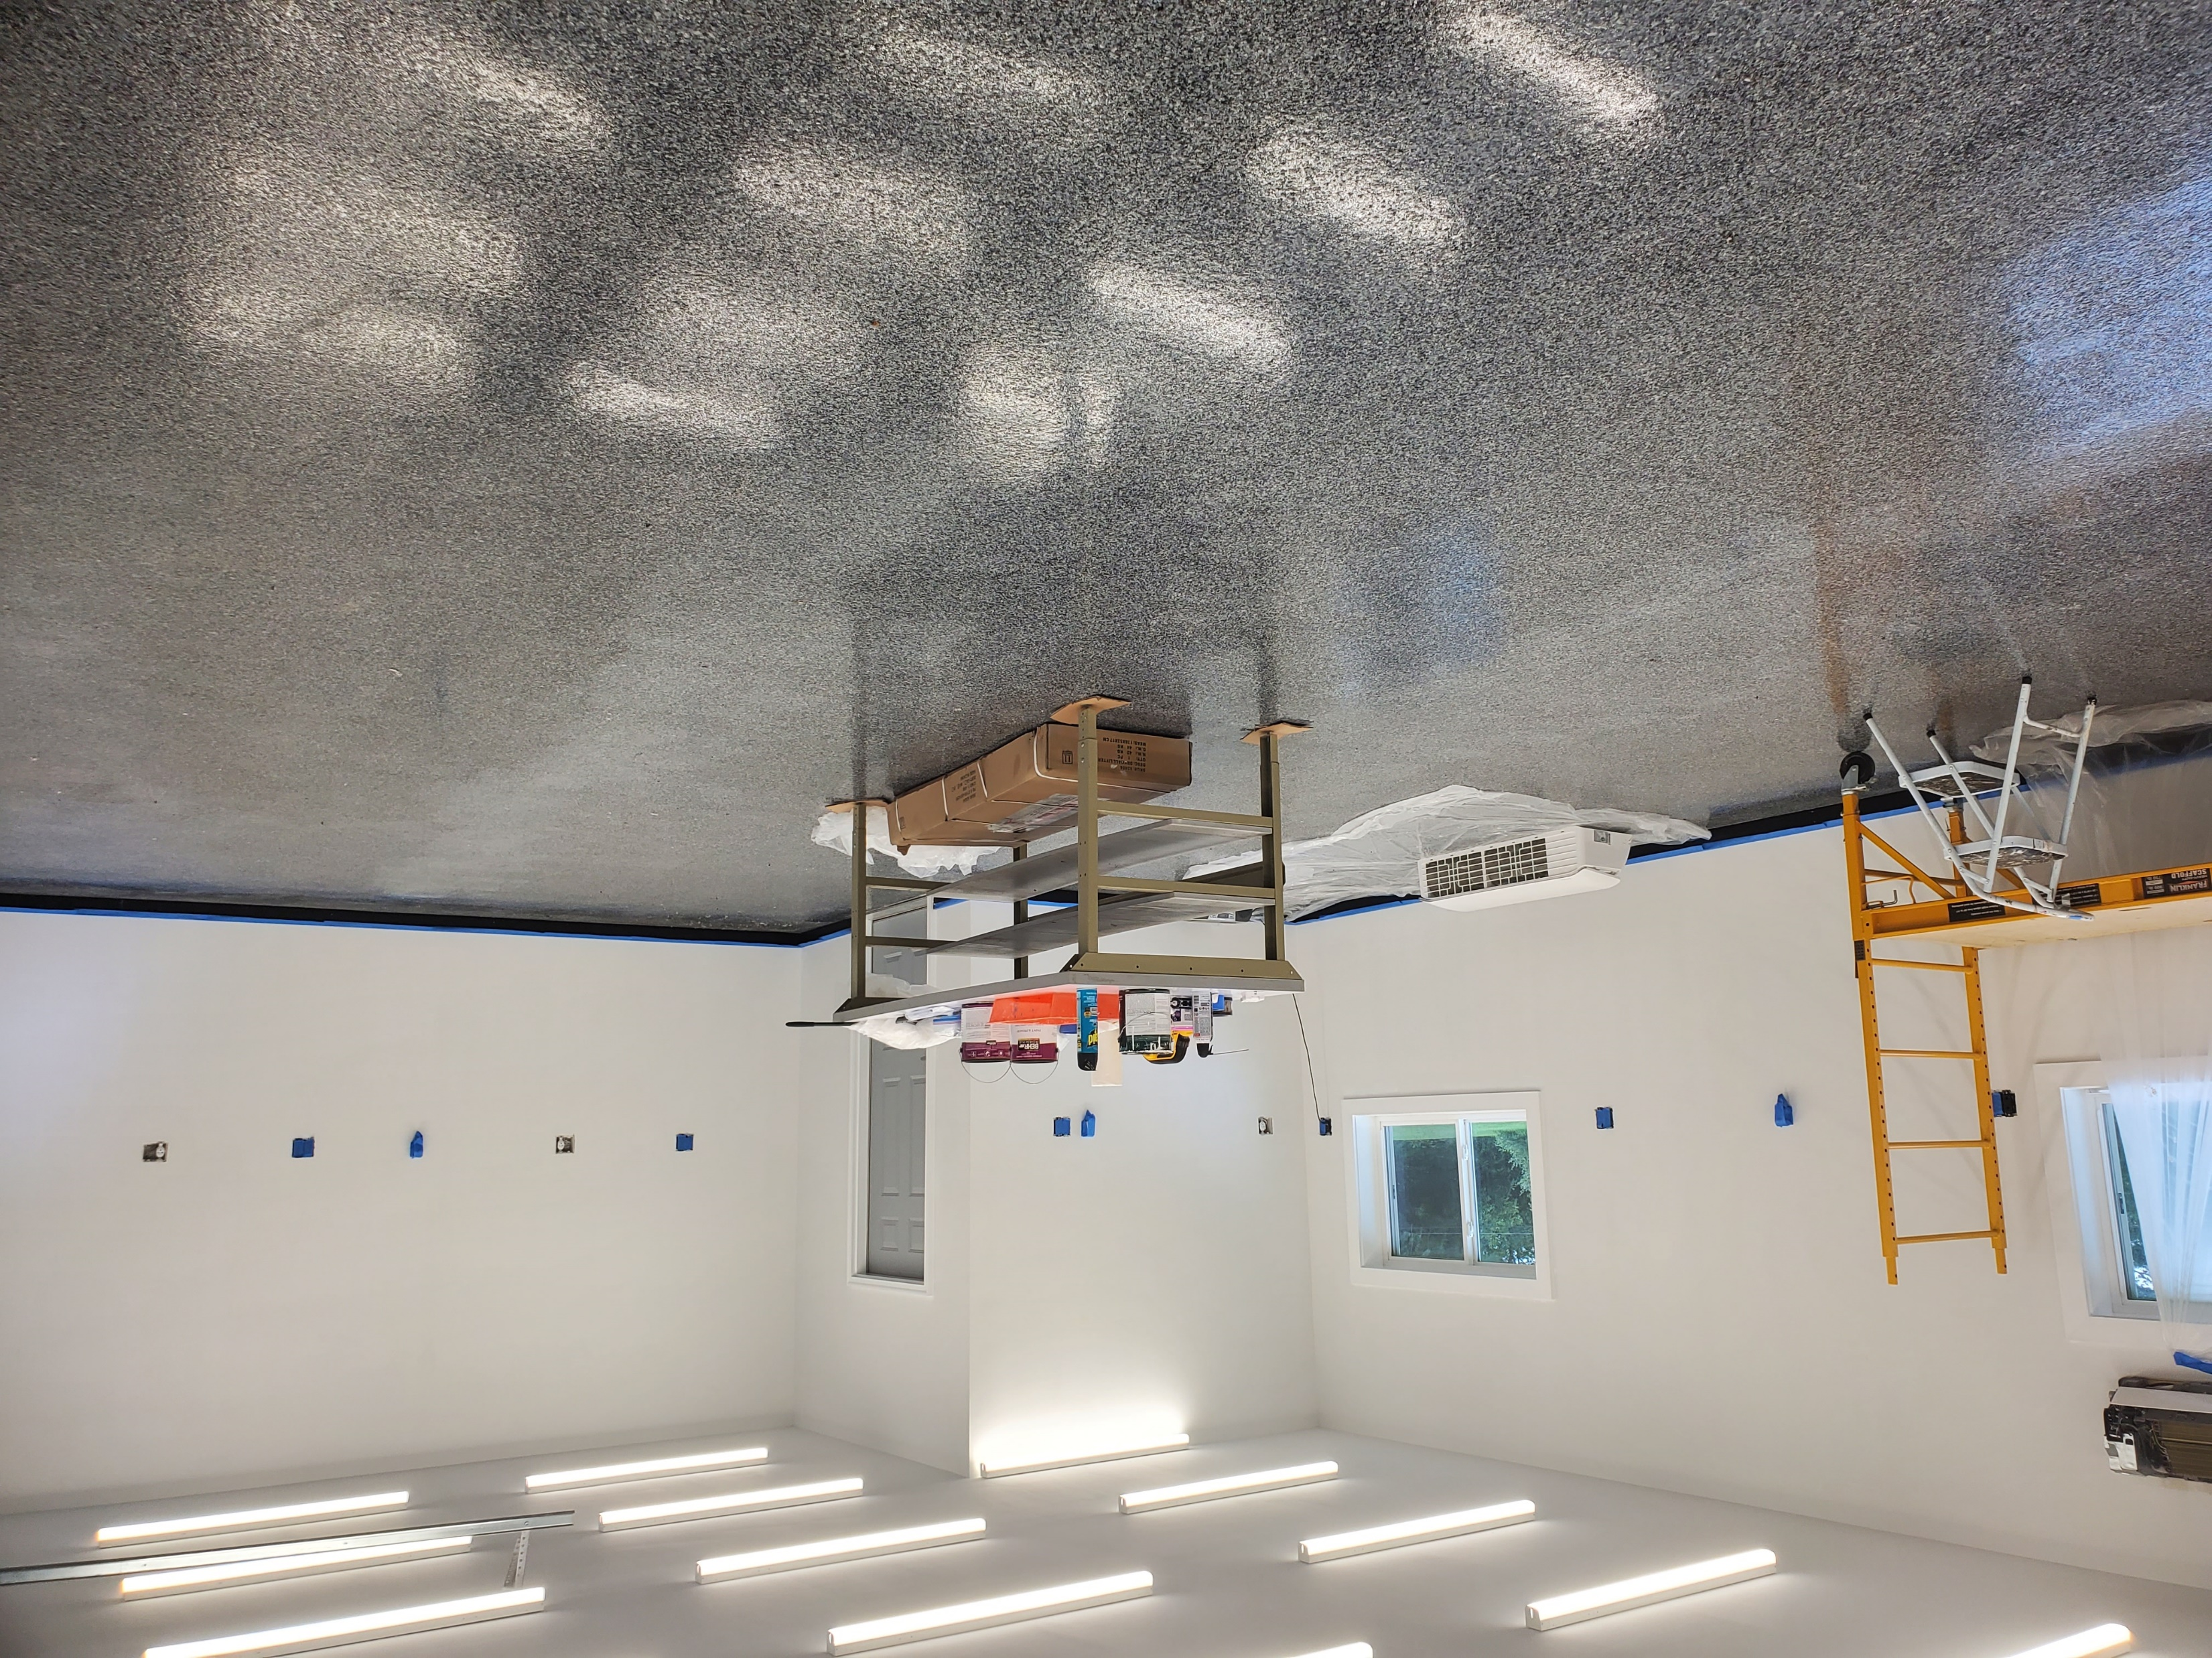
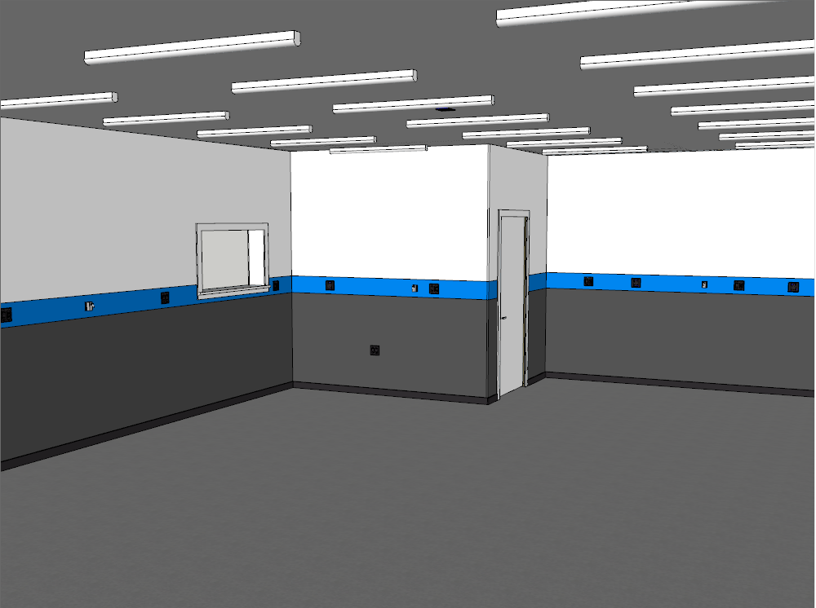
The Shop

Slide 24
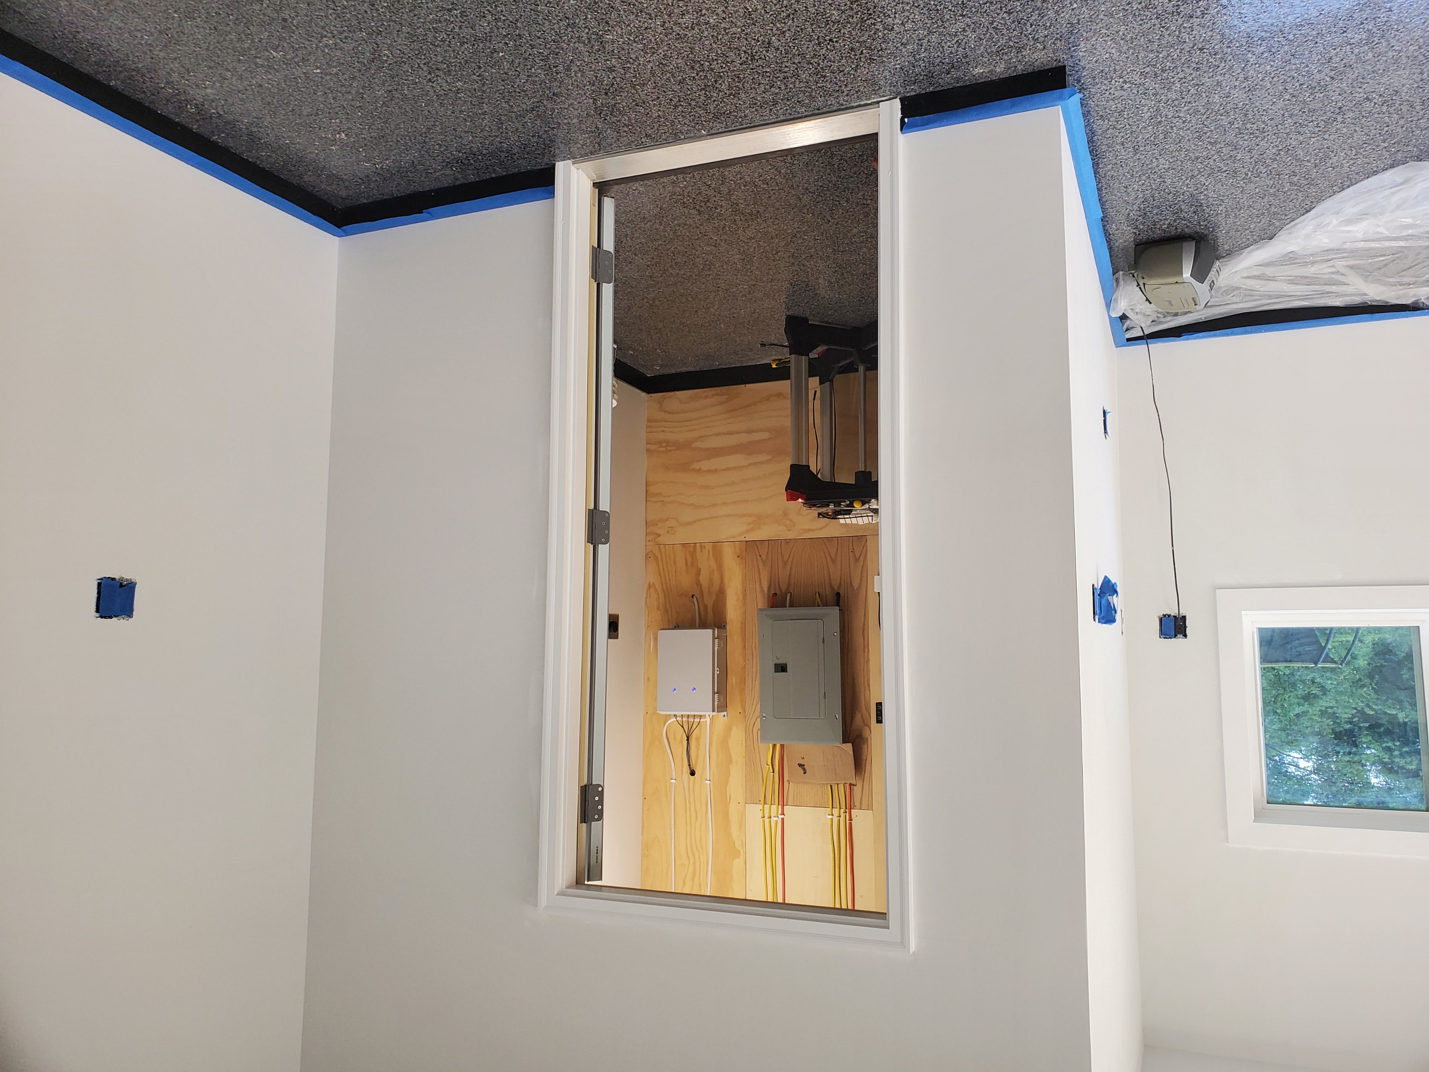
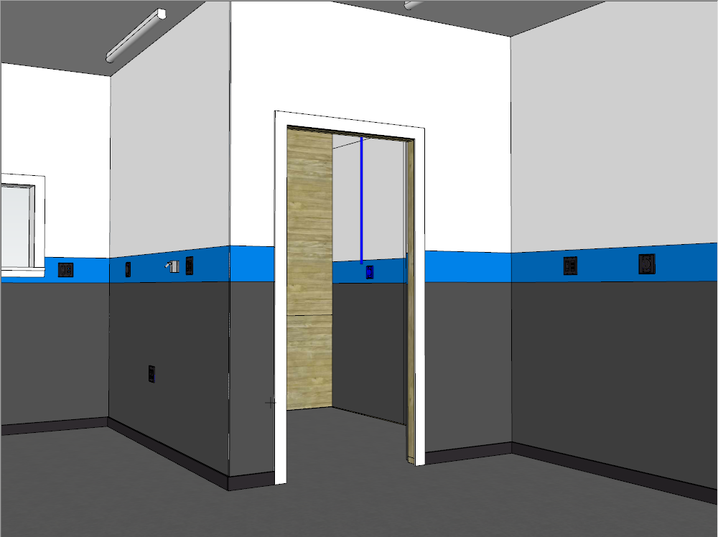
The Shop

Slide 25
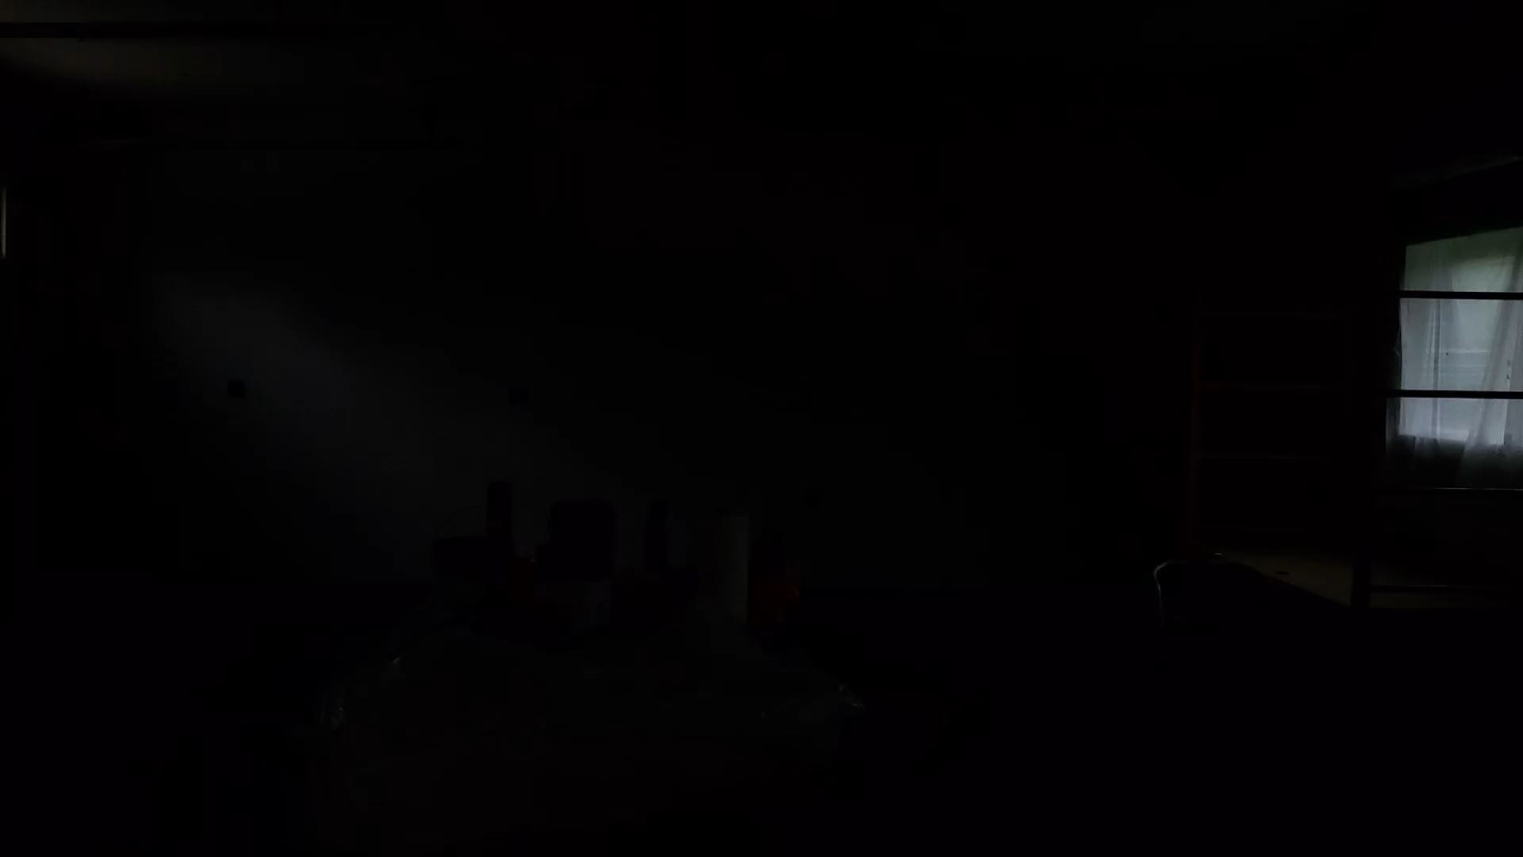
The Shop

Slide 26
Wrap up
Slides can be found on GitHub
https://github.com/brentestewart
brent@alienarc.com
Twitter - @brentestewart
Instagram - @makingofbrent

